Slide 1
MIGS: What Does it
Mean To Optometry?
Sean W. Smolenyak, OD
Kelly Eye Center
Raleigh, NC

Slide 2
DISCLOSURES
The content and format of this course is presented without commercial bias and does not claim superiority of any commercial product or service
Dr. Sean W. Smolenyak is affiliated with Allergan, Bausch & Lomb, Glaukos, Aerie and Sun Pharmaceuticals as a speaker and/or consultant.
Dr. Sean W. Smolenyak has no direct financial or proprietary interest in any companies, products or services mentioned in this presentation.

Slide 3
Glaucoma Prevalence and Patient Need

Slide 4
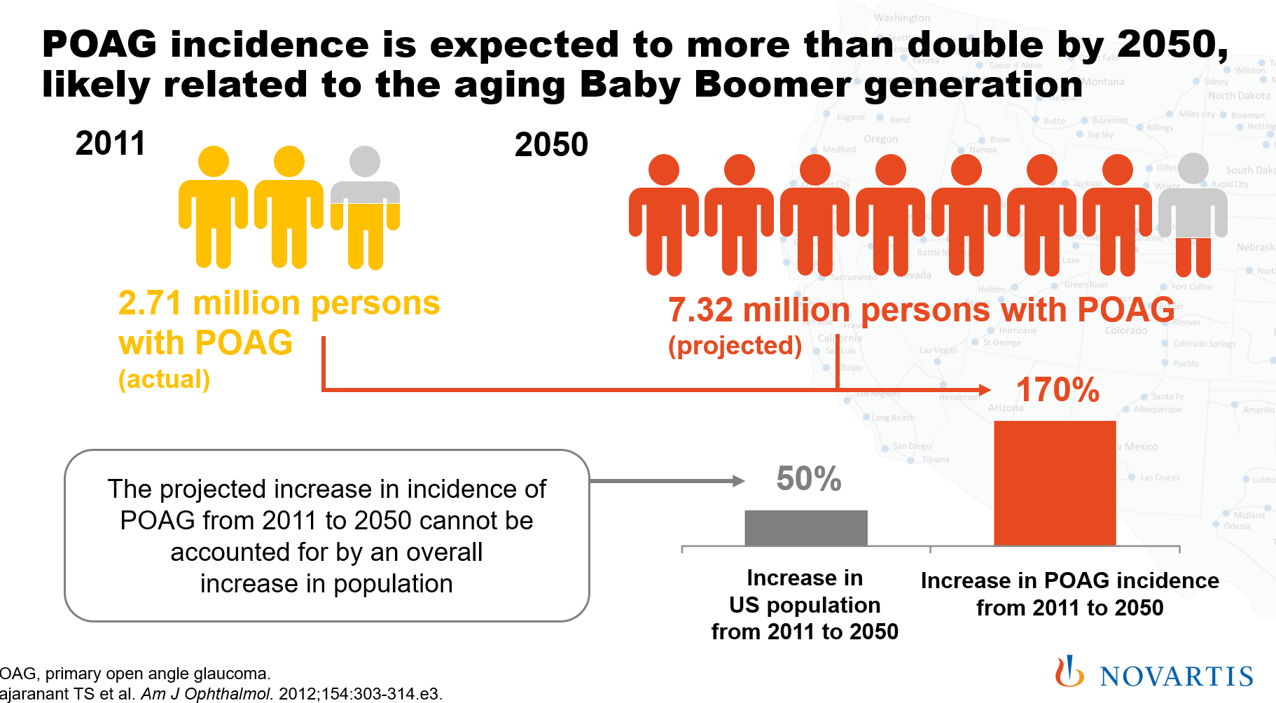

Slide 5
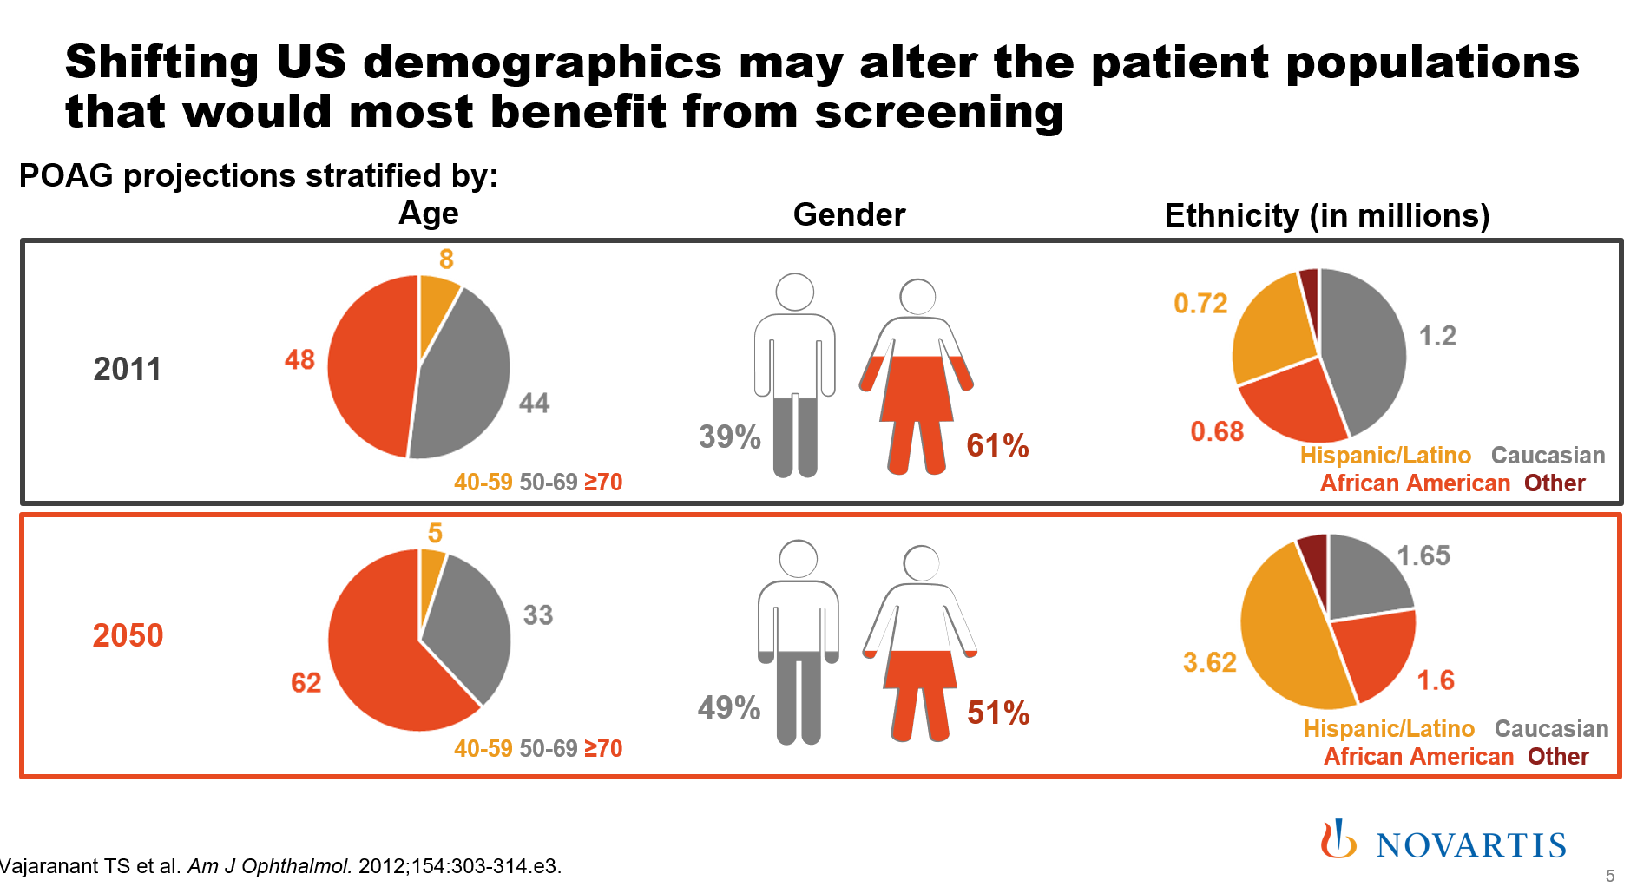

Slide 6
Why Should We Get Involved?
Declining or at least neutral levels of Ophthalmologists
Patients will continue to turn to Optometrists for treatment of ocular disease
Much to be done as #2 cause of blindness in developed nations
40% of patients already have VF loss at time of diagnosis AND can have a huge impact on quality of life of patients (reduced mobility & activity, increased depression)
10% of glaucoma patients will lose vision over time EVEN WITH TREATMENT
Optometrists are prescribing more ophthalmic medications (even though 20% write 80%)
In simple terms, there is the demand but we have to rise to the occasion to manage and treat it
Dangers include the rise of AI, data collection centers (remote monitoring) and apathy (scope expansion)

Slide 7
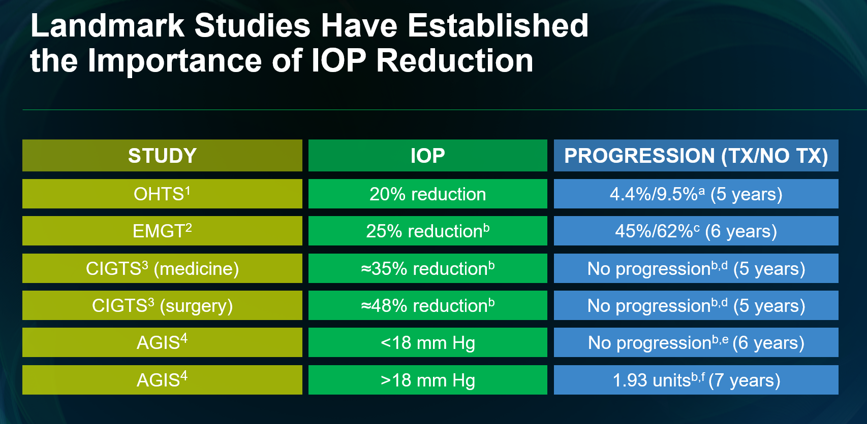

Slide 8
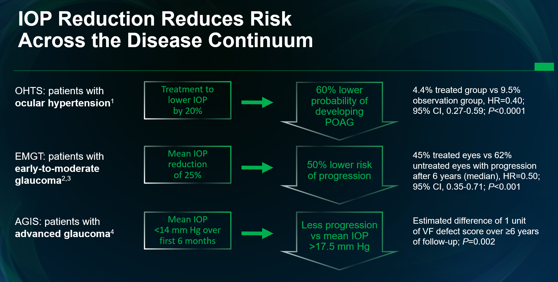

Slide 9
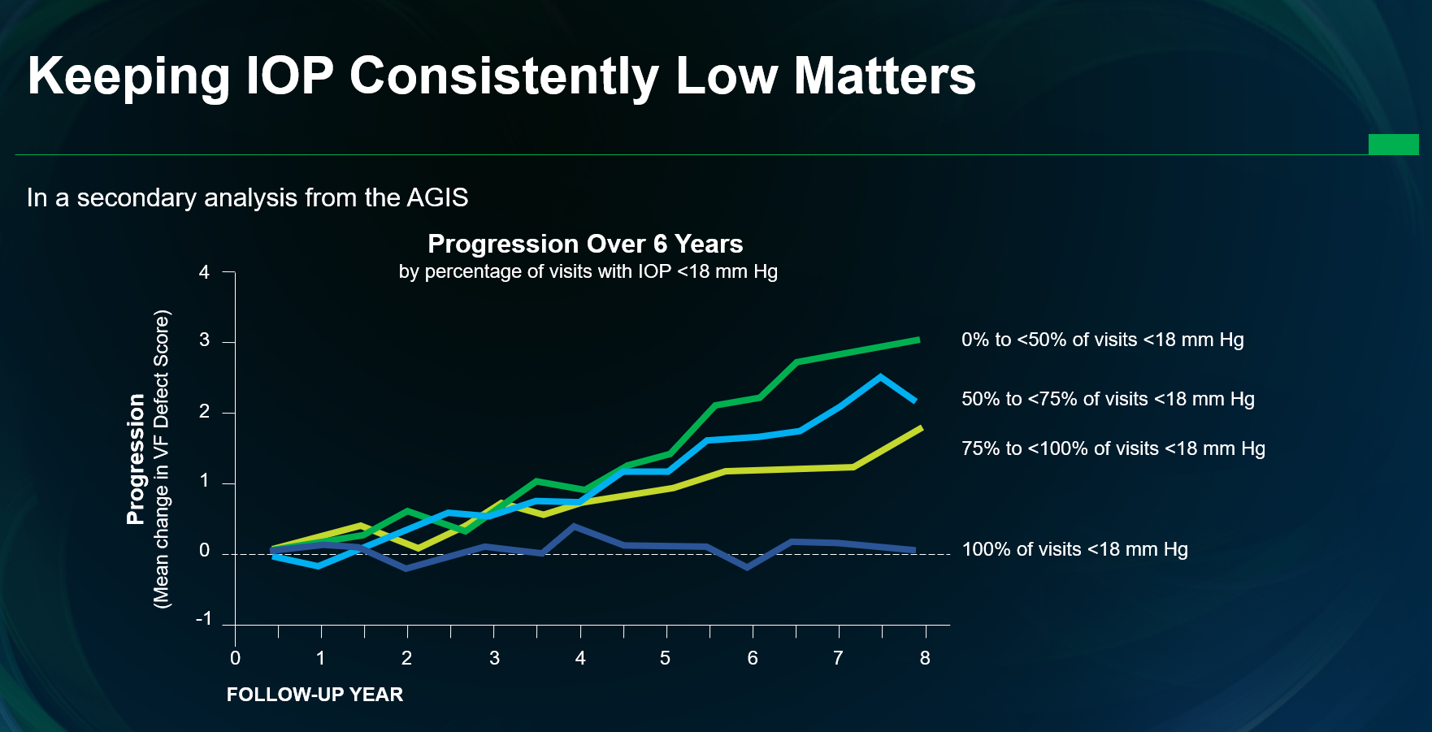

Slide 10
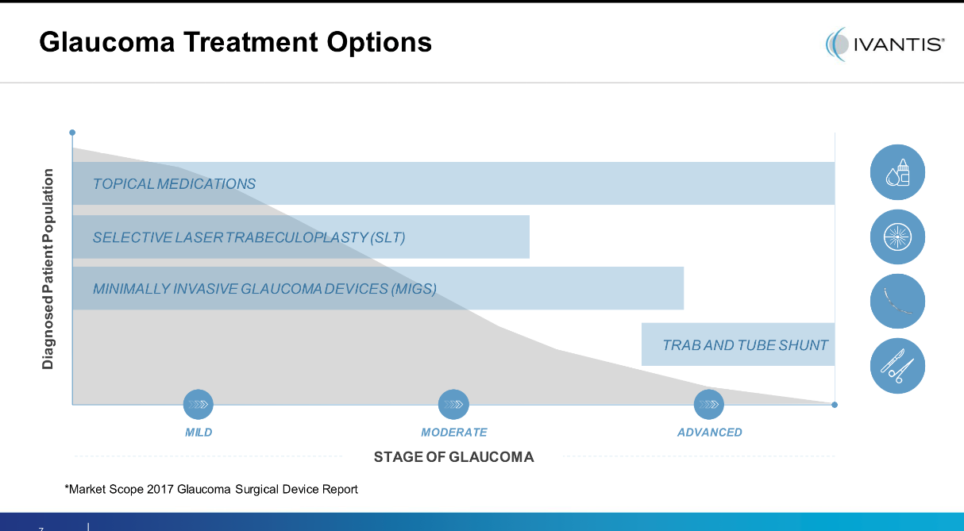

Slide 11
Standard Treatment Options for Glaucoma
Challenges
Long-term exposure to glaucoma medication can cause corneal surface damage
Non-compliance to medication
  More than 90% of patients are non-adherent, and nearly 50% stop taking their medications before 6 months
Less durability in laser treatments?
Risks associated with invasive surgery
Cost burden to patients & system
Standard Treatment Options
Glaucoma Medications
Laser Trabeculoplasty
Invasive Surgery
  Trabeculectomy / Shunt
iStent inject offers cataract patients with glaucoma a new option that can relieve eye pressure and may reduce reliance on medication

Slide 12
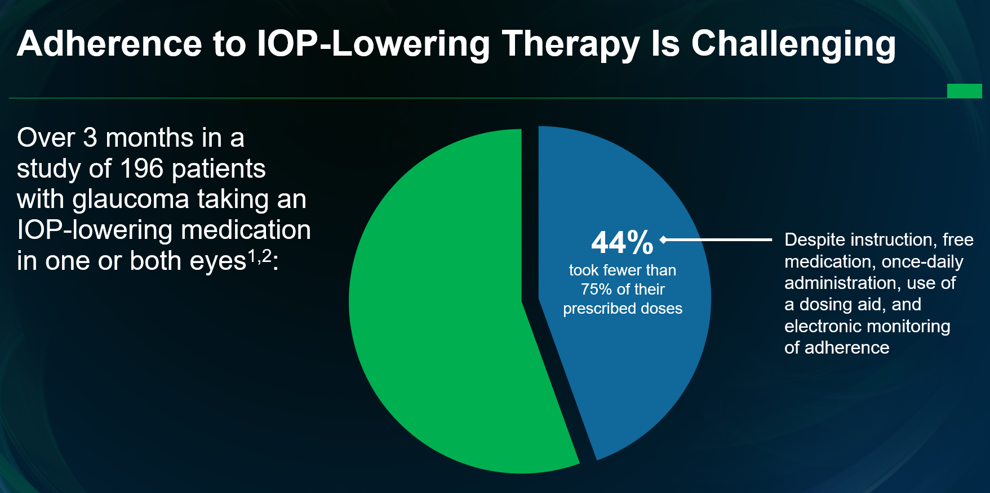

Slide 13
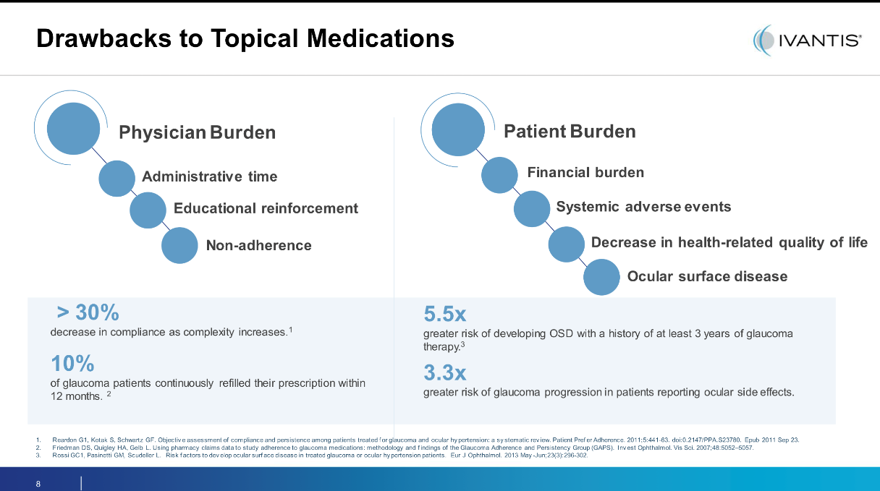
The Burdens Associated with Topical Therapy

Slide 14
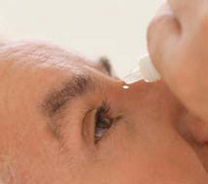
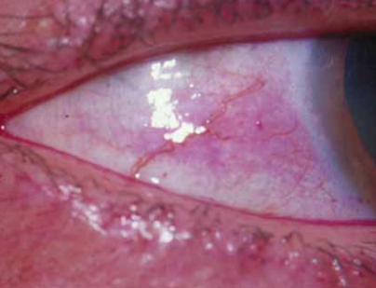
Glaucoma Medications & Ocular Surface Disease (OSD)
Nearly 60% of Medically Treated Glaucoma Patients
Report OSD Symptoms
Reduction in topical glaucoma medications, which typically contain the preservative benzalkonium chloride (BAK), can help maintain the quality of tear film and potentially improve refractive outcomes.

Slide 15
Search for the Best Glaucoma Drop
The typical eyedrop is 30-50 microliters BUT the eye can only absorb 6-8 mcl
Therefore every eyedrop is an overdose which can lead to ocular and systemic toxicity (not to mention financial waste!)
Many glaucoma patients have trouble administering drops (studies show maybe only 39% do it correctly)
Efforts underway to create a new dropper: reduce amount and make it easier to apply
Eyenovia working on Optejet container that acts like a spray, delivering the drug faster than the eyes blink reflex

Slide 16
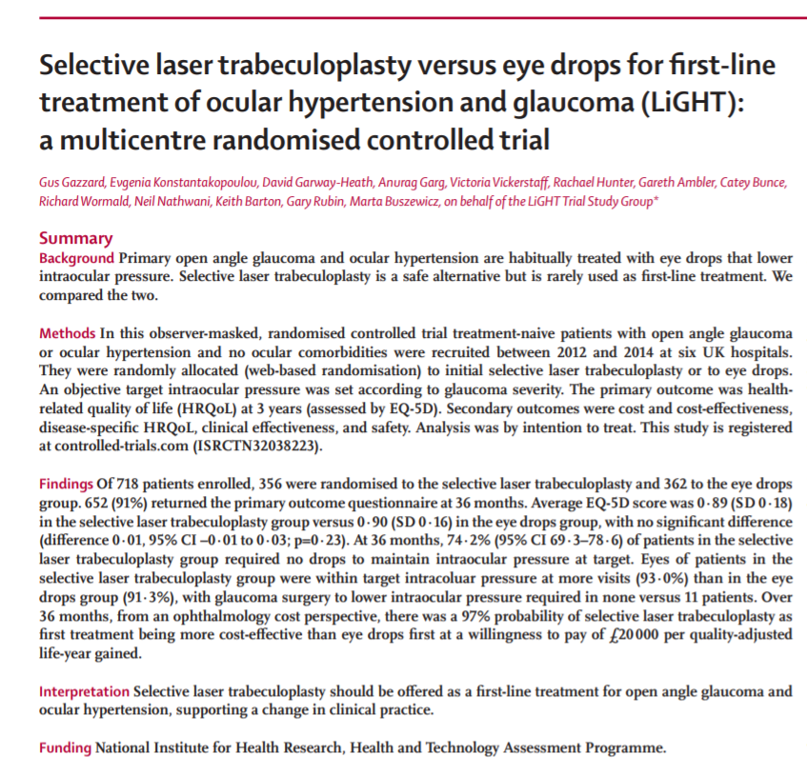
SLT: The Light Study
What are the implications
from this study?
Should we be scared?
Is it all about the control?

Slide 17
Mild-to-Moderate Glaucoma Predominates
77% mild-to-moderate
Paradigm Shift to Surgical Options Earlier

Slide 18
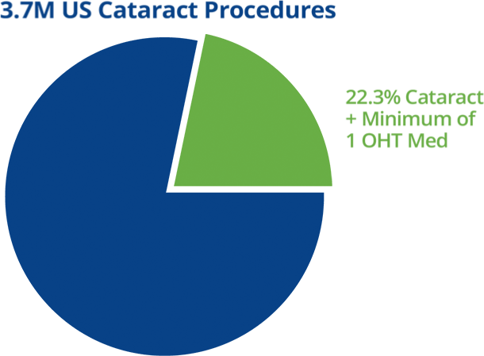
Concomitant Cataract & Glaucoma Patients ‒ US
Significant treatment opportunity with cataract surgery volume growing over 3% per year and more than 1 in 5 eyes with cataracts on OHT medication
3.9M US Cataract Procedures
22.3% Cataract + Minimum of 1 OHT Med

Slide 19
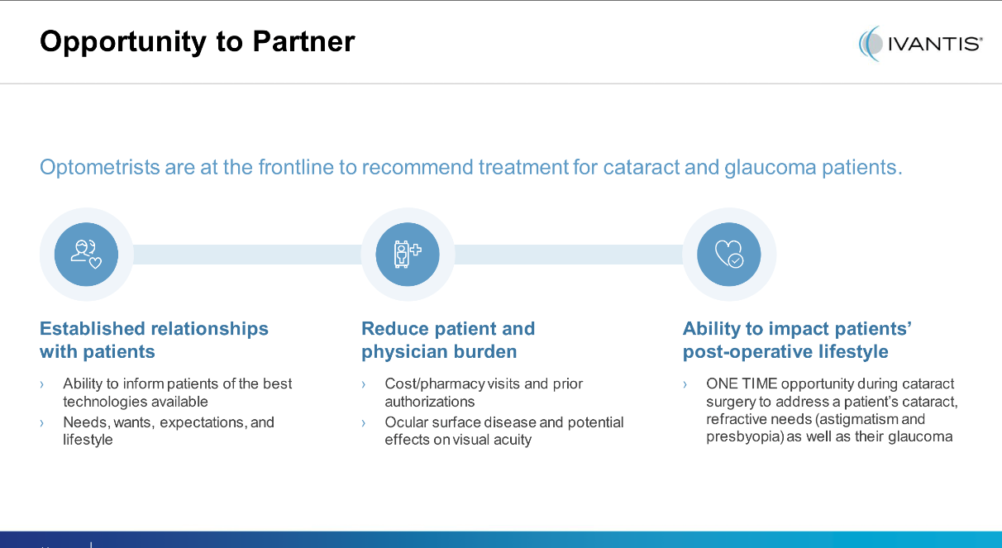
Opportunity to Partner

Slide 20
AQUEOUS HUMOR OUTFLOW
Conventional Outflow
The aqueous humor leaves the eye at the anterior chamber angle through trabecular meshwork, the Schlemm’s canal, intrascleral channels, and episcleral and conjunctival veins.
Trabecular outflow accounts for 70-95% of the aqueous outflow.
Unconventional Outflow
The aqueous humor exits through the root of the iris, between the ciliary muscle bundles, then through the suprachoroidal-scleral tissues.
5-30% by uveoscleral outflow.

Slide 21
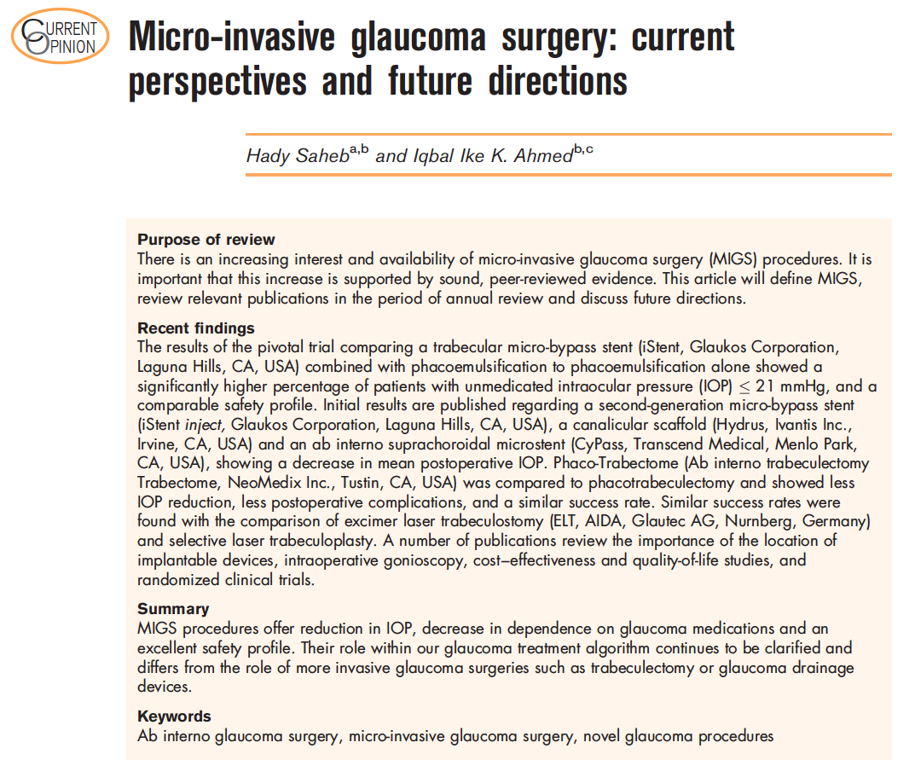
The Goal of Micro-Invasive Glaucoma Surgery
MIGS Definition
  Ab interno
  Minimally traumatic, tissue sparing
  Proven efficacy
  Extremely high safety profile
  Rapid recovery

Slide 22
So Many to Choose From!!
iStent inject, iStent
Hydrus
Xen
Cypass
Endocyclophotocoagulation (ECP)
Kahook Dual Blade (KDB)
Goniotome/Trabectome
GATT
Omni Surgical System
Ab interno canaloplasty (ABiC)

Slide 23
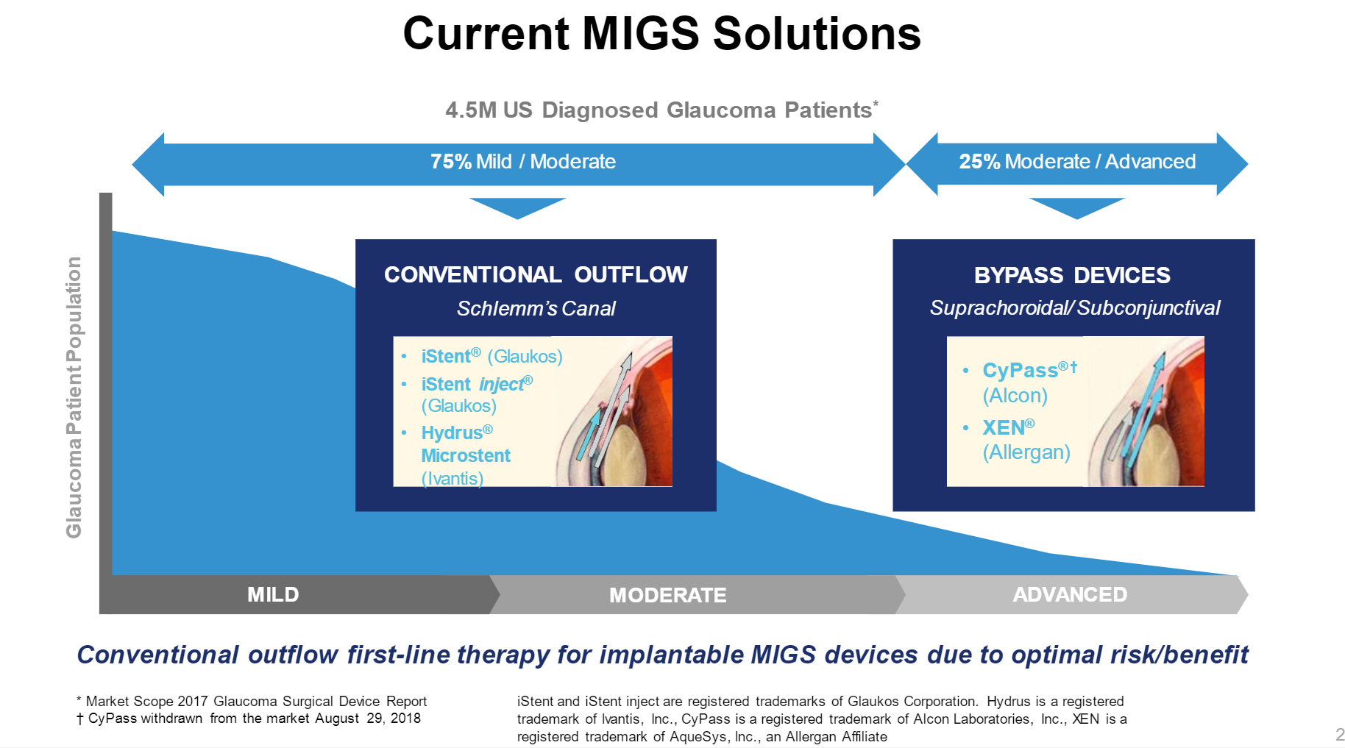

Slide 24
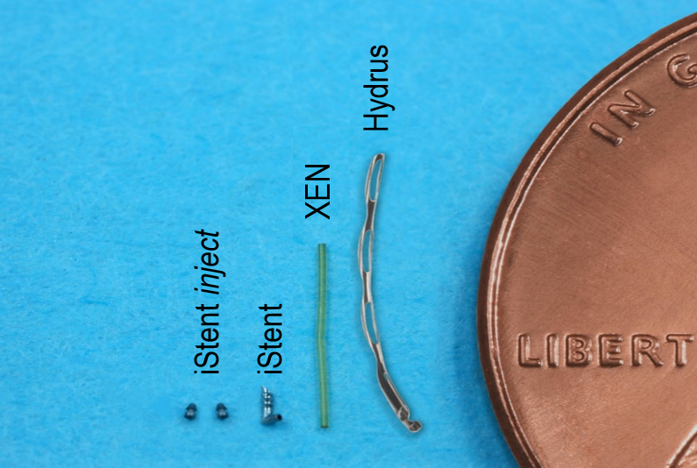
MIGS Technologies

Slide 25
MIGS Treatment Algorithm

Slide 26
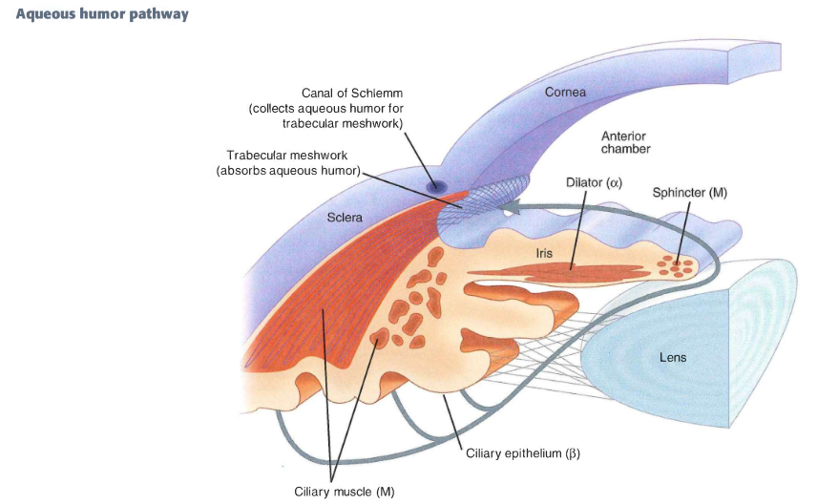
Areas of Aqueous Outflow
MIGS devices can be used to restore outflow through:
Outflow Pathway | Disease State
Trabecular Meshwork | Mild-to-Moderate
Suprachoroidal Space | Progressive
Subconjunctival Space | Refractory
1
1
3
2
2
3
Benefit-to-risk ratio is the ultimate criterion in determining MIGS treatment algorithm

Slide 27
Considerations for Treating Mild-to-Moderate OAG
Safety
Efficacy
Predictability/
Patency
Practice
Efficiency
First do no harm
Minimal intraoperative, short- and long-term postoperative sequelae
Ideal post-treatment target pressures of
≤ 15 mm Hg with ≤ 1 medication
≥ 20% IOP reduction from preoperative baseline
Consistent, sustained IOP reduction over multiple years
Enhances practice offering
Minimal disruption related to post-surgical sequelae, visual rehabilitation or administrative burdens

Slide 28
MIGS: Mild-to-Moderate Disease Intervention
Trabecular Bypass First
  Designed to restore and maintain natural physiological outflow
    Up to 75% of resistance to outflow
  Overall safety profile consistent with cataract surgery alone
    Episcleral venous back pressure of 8-11 mm Hg
  Maintaining the natural pathway avoids atrophy of Schlemm’s canal
  Foundational therapy preferred safety-to-benefit option for mild-to-moderate intervention

Slide 29
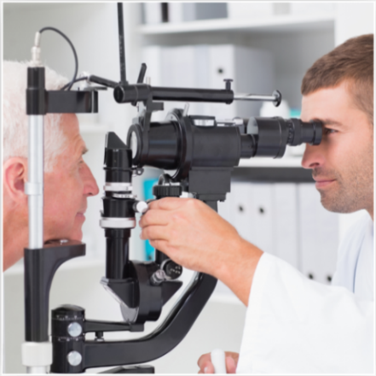
Diagnostic Testing for a MIGS Procedure
Manifest refraction and brightness acuity testing
Careful slit lamp examination
  Document existence of any secondary glaucomas such as pseudoexfoliation syndrome and pigment dispersion syndrome
Glaucoma workup
  Visual field (determining factor!)
  Optic nerve head OCT
  Pachymetry
  IOP
    Gonioscopy – evaluating for synechia, iris processes, narrow anatomical angles, angle recession or any other abnormalities of the angle structure that may interfere with placement of device
    Dilated fundus examination – rule out moderate/severe retinal pathology
    Optic nerve head evaluation

Slide 30
Co-Management Considerations
Establish medical necessity for cataract and glaucoma surgery
Accurately document all preoperative evaluations or diagnostic tests
Obtain patient consent to co-management
  Clearly explain and document patient logistics
  Financial arrangement disclosures
  Consent to share information between surgeon and postop care provider
  Provisions if complications occur
  Signatures (patient, surgeon, co-managing doctor)

Slide 31
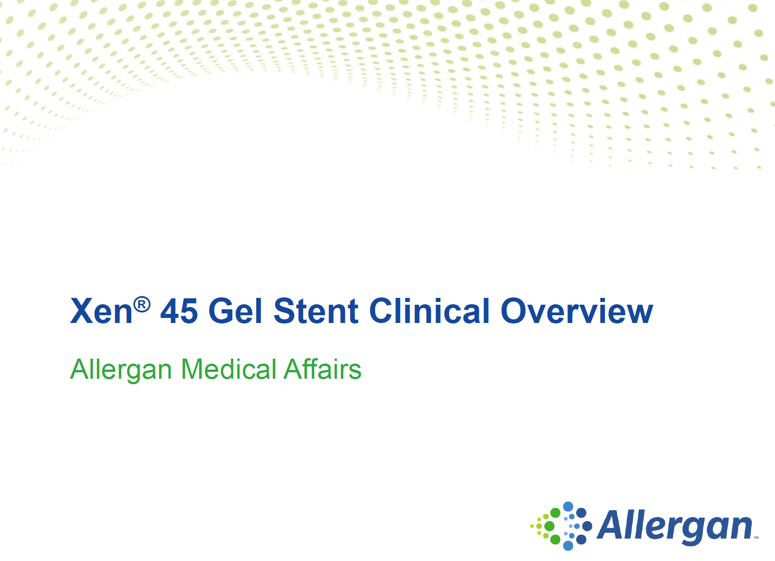
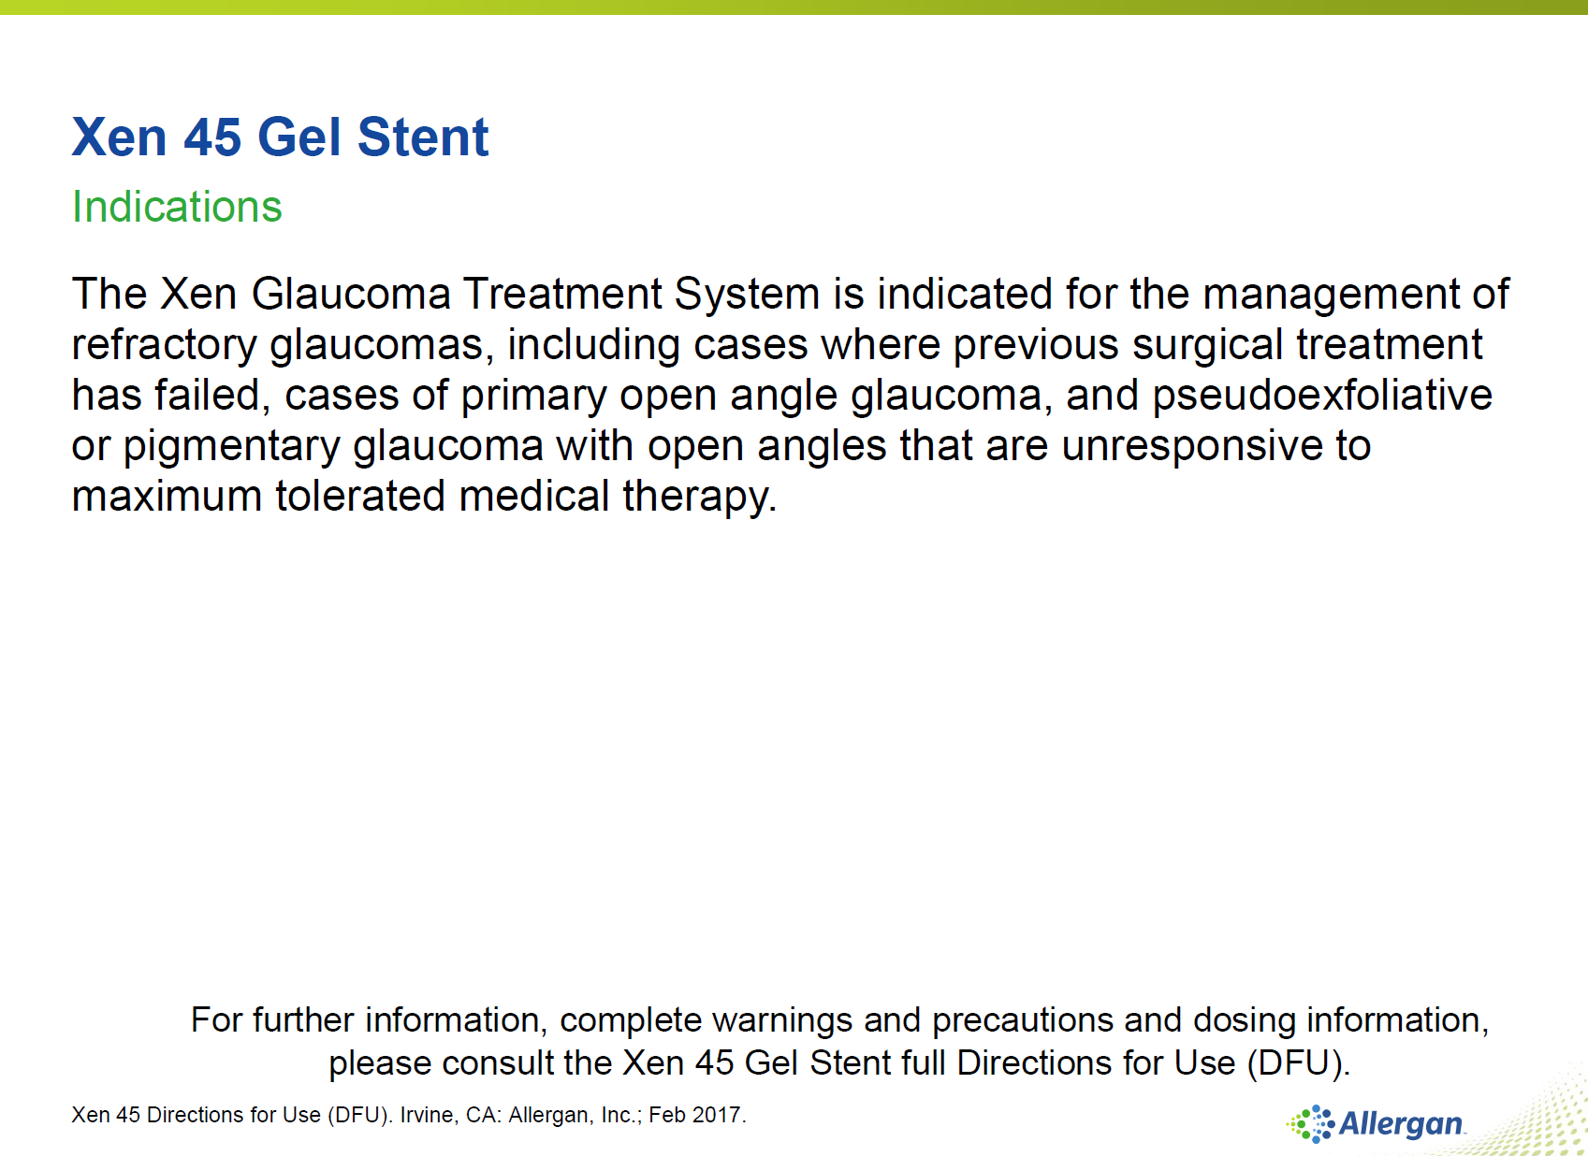

Slide 32
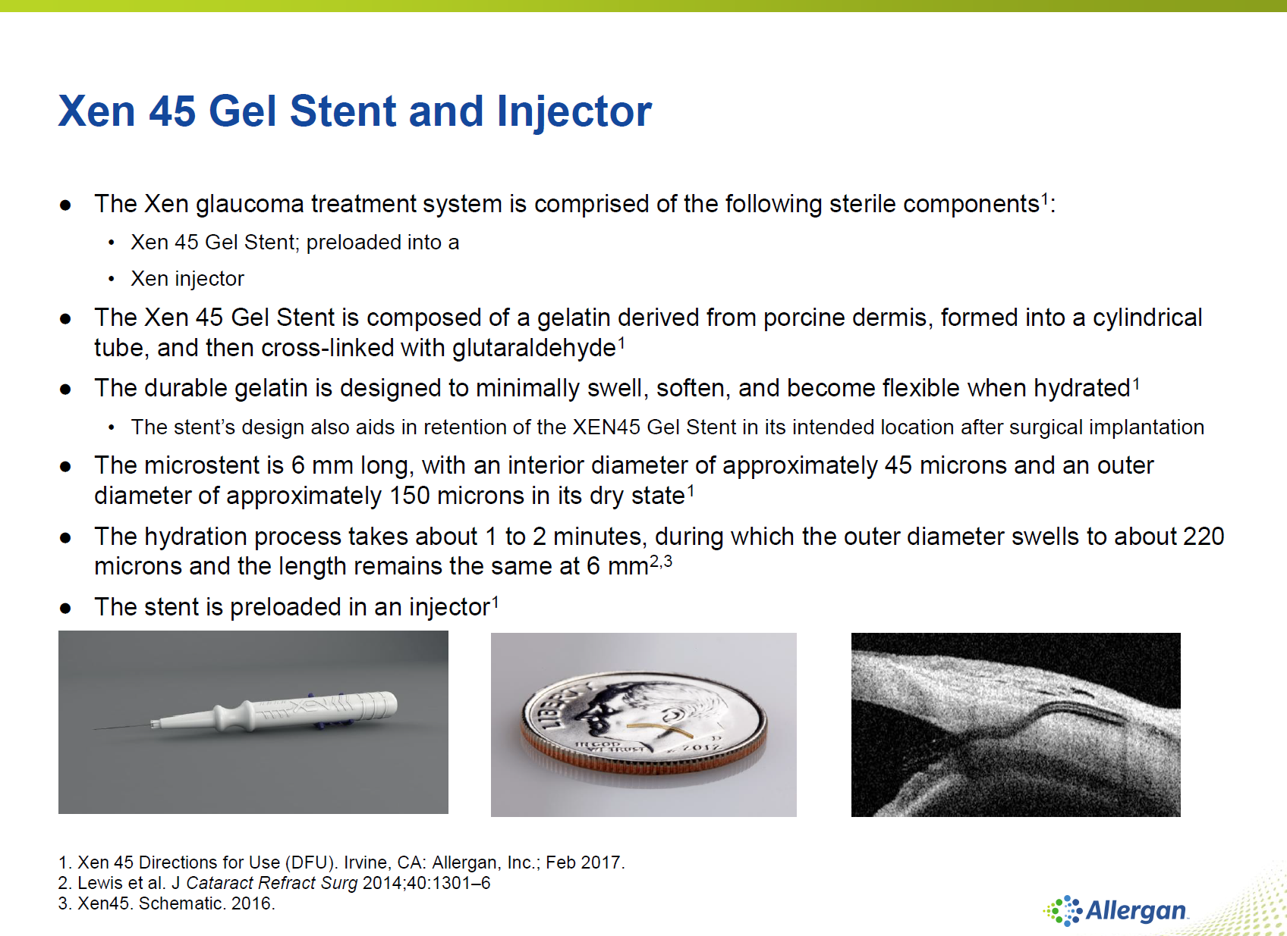

Slide 33
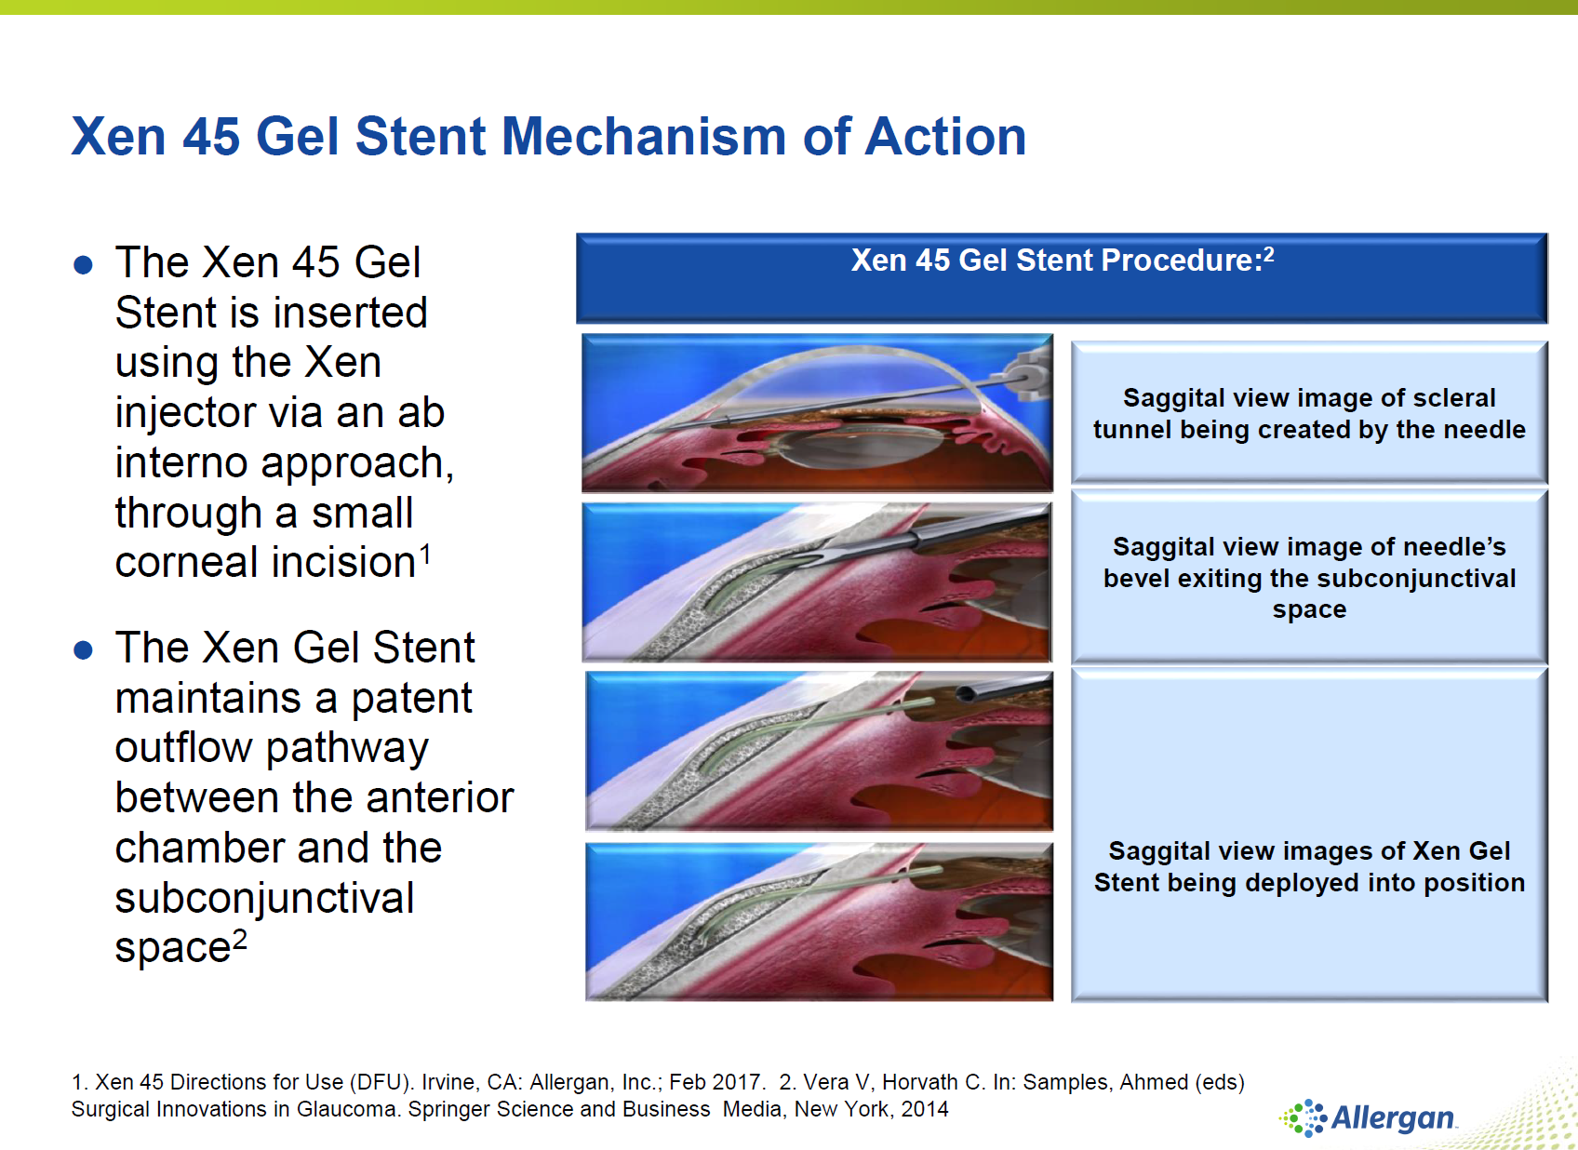

Slide 34
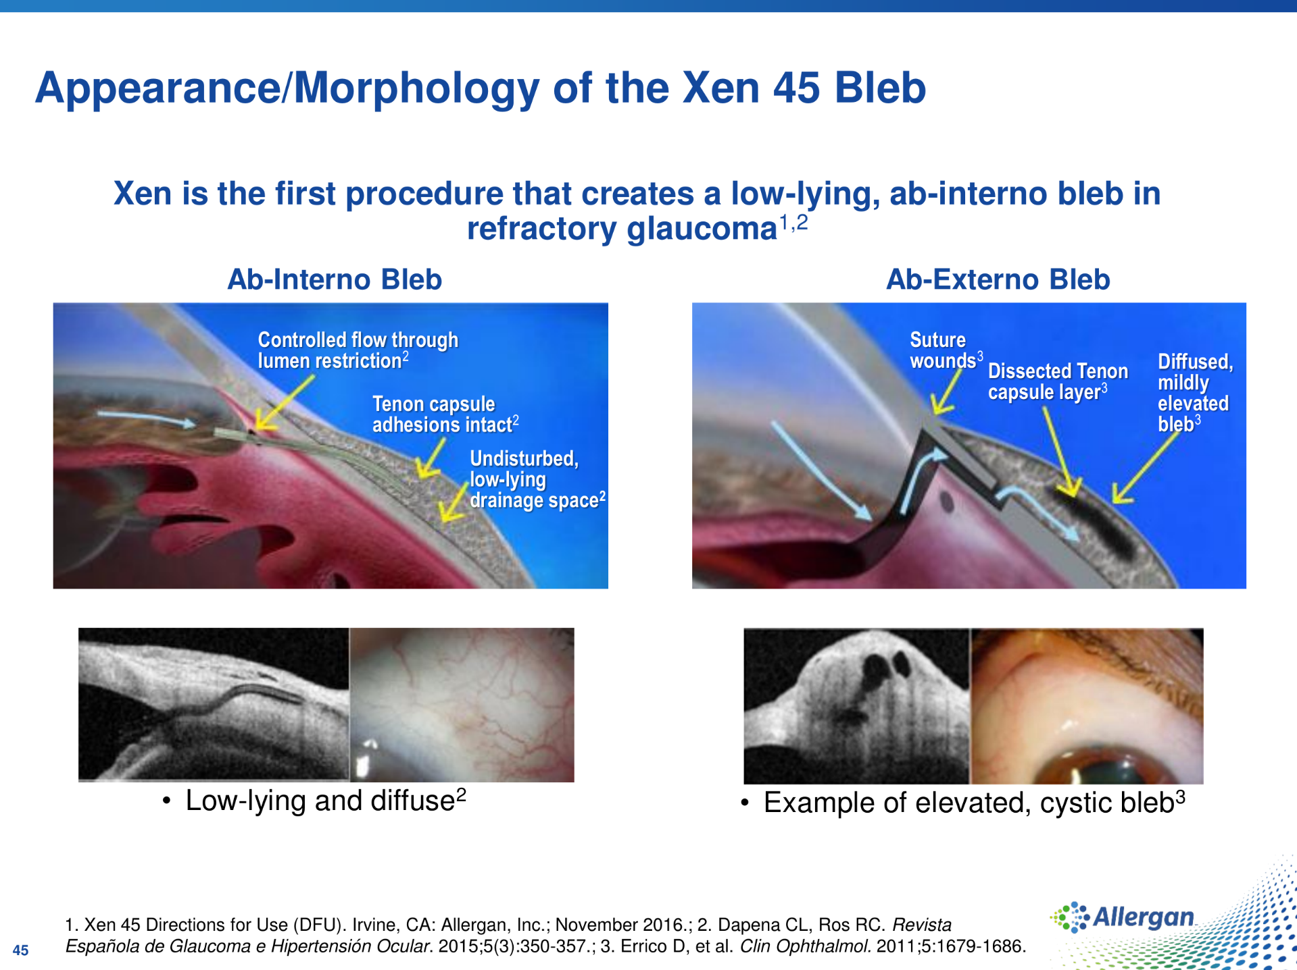

Slide 35
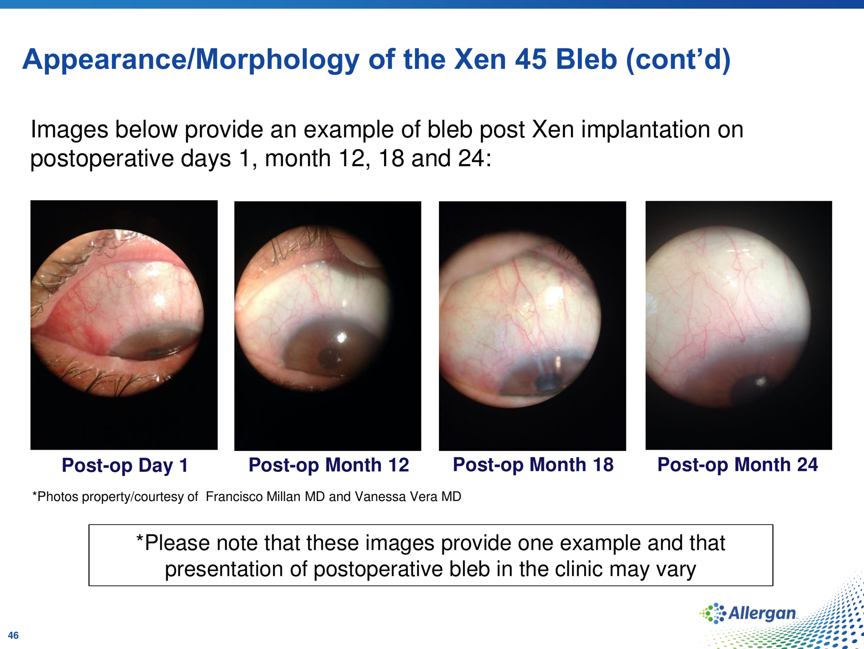

Slide 36
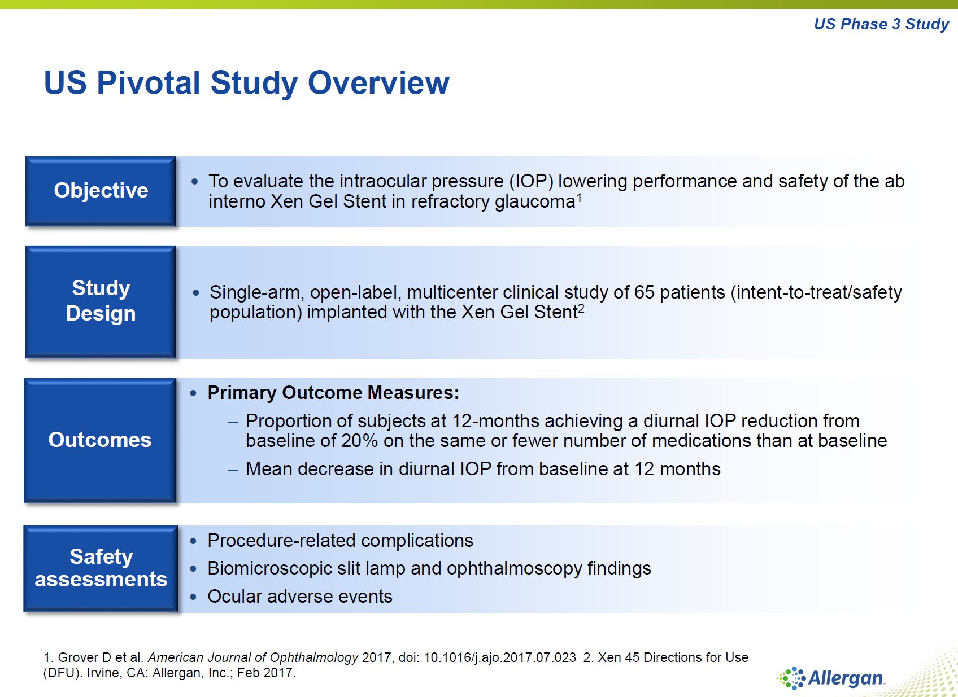

Slide 37
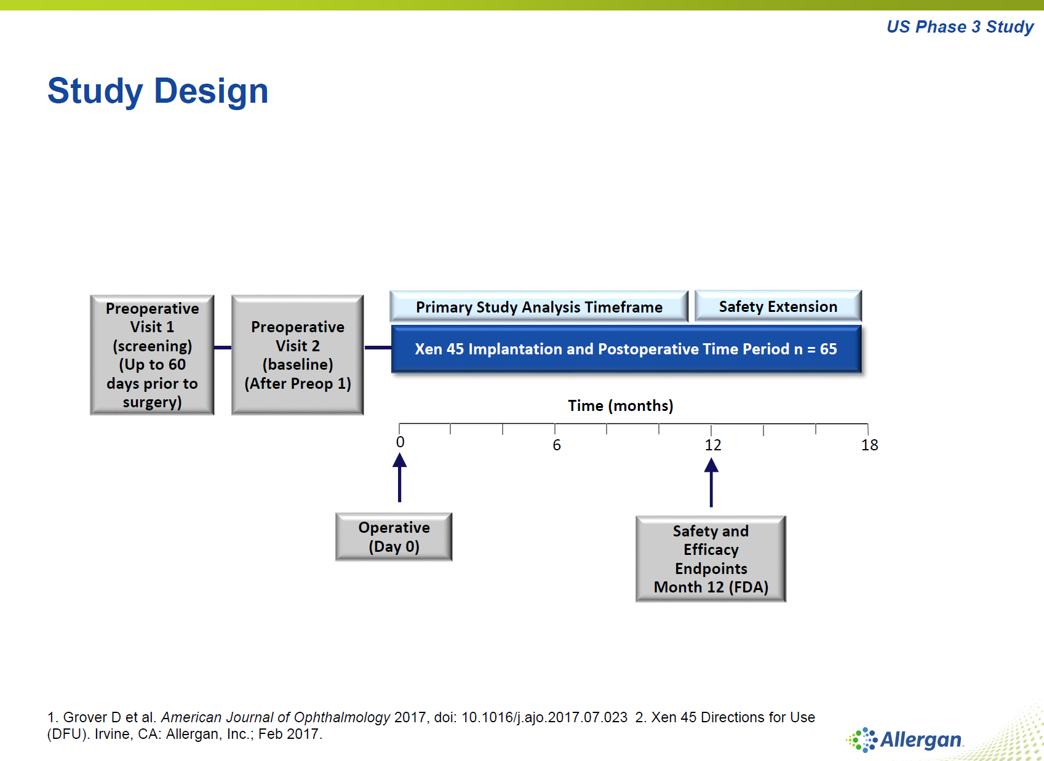

Slide 38
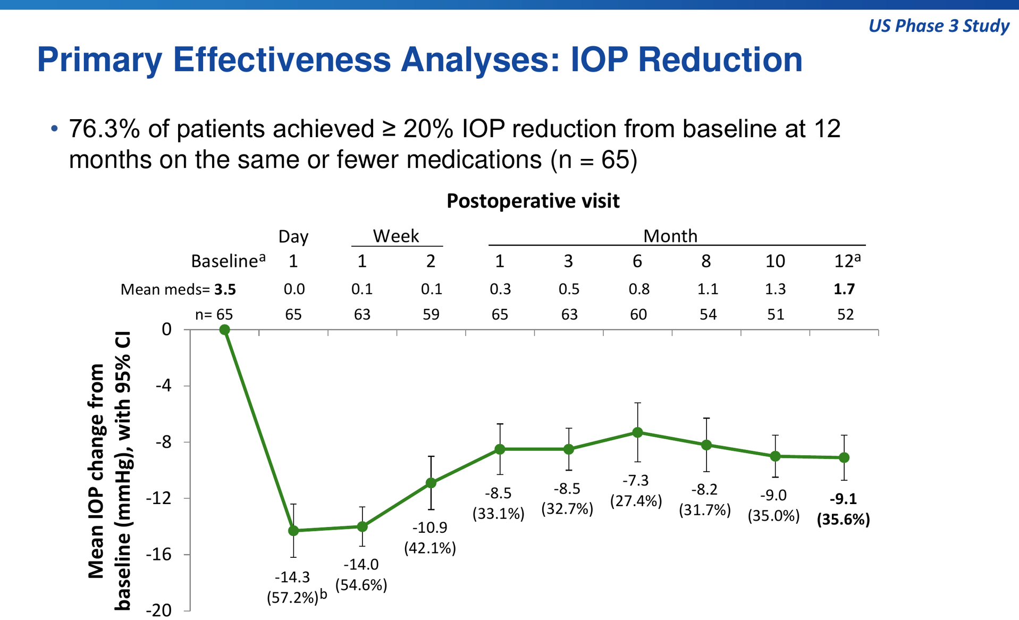

Slide 39
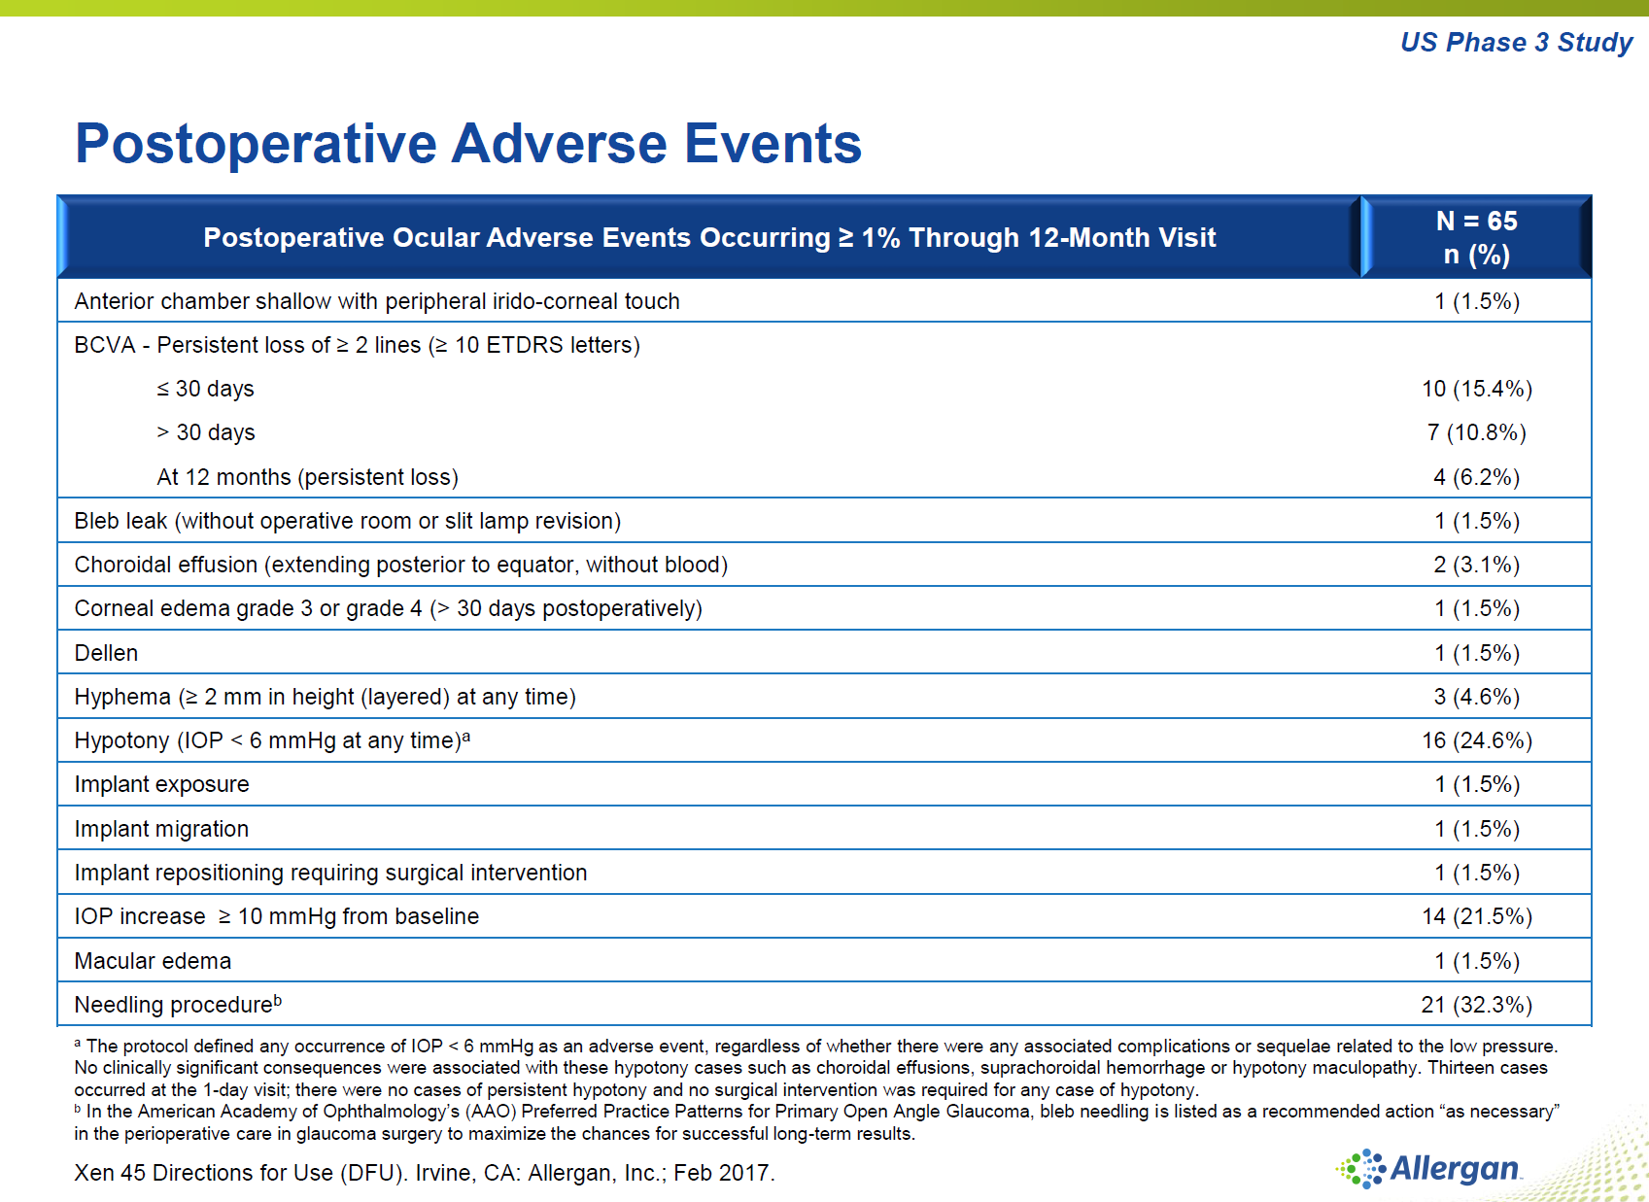

Slide 40
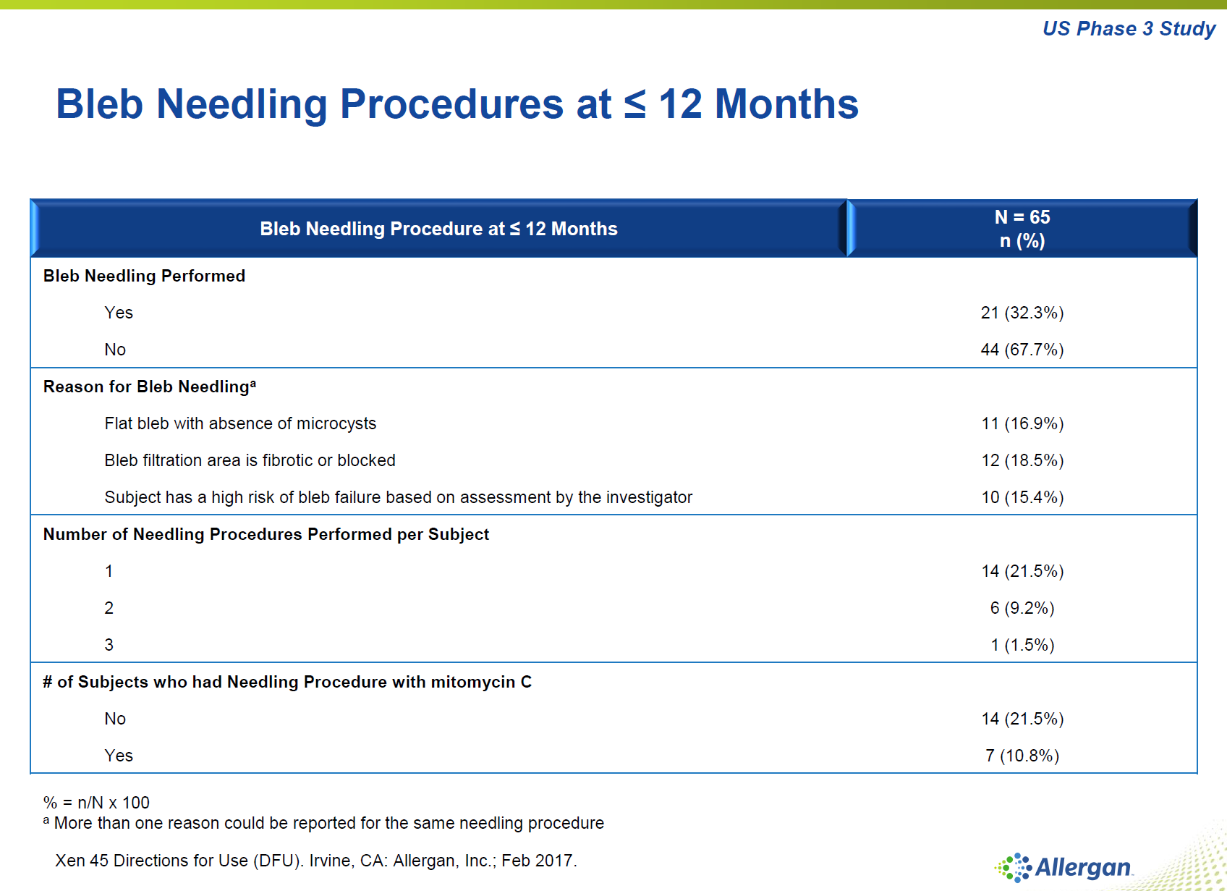

Slide 41
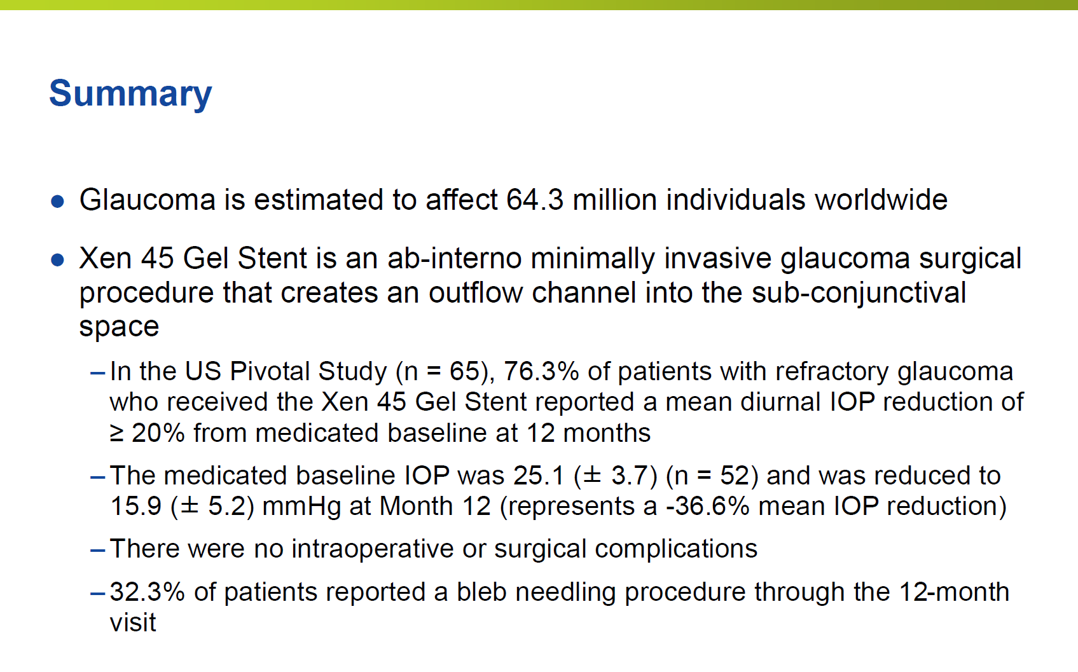

Slide 42
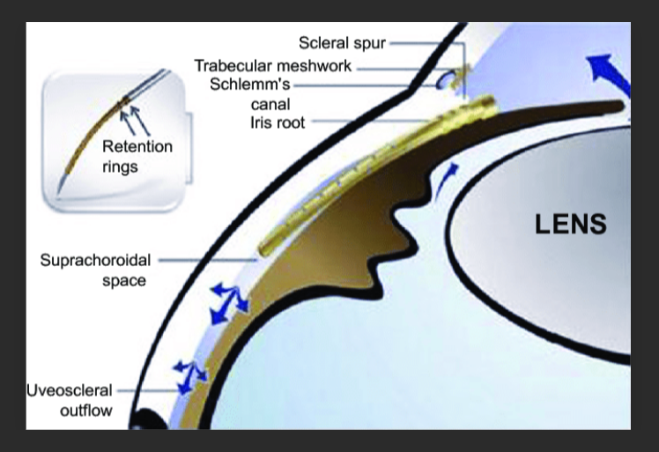
What About Cypass?

Slide 43
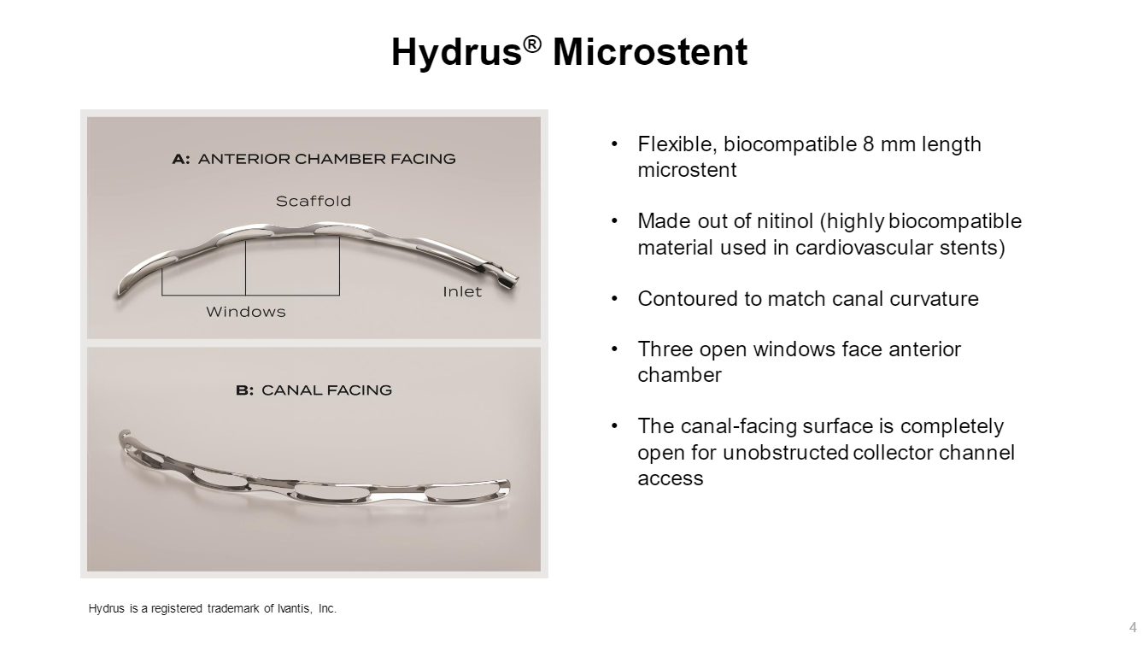

Slide 44
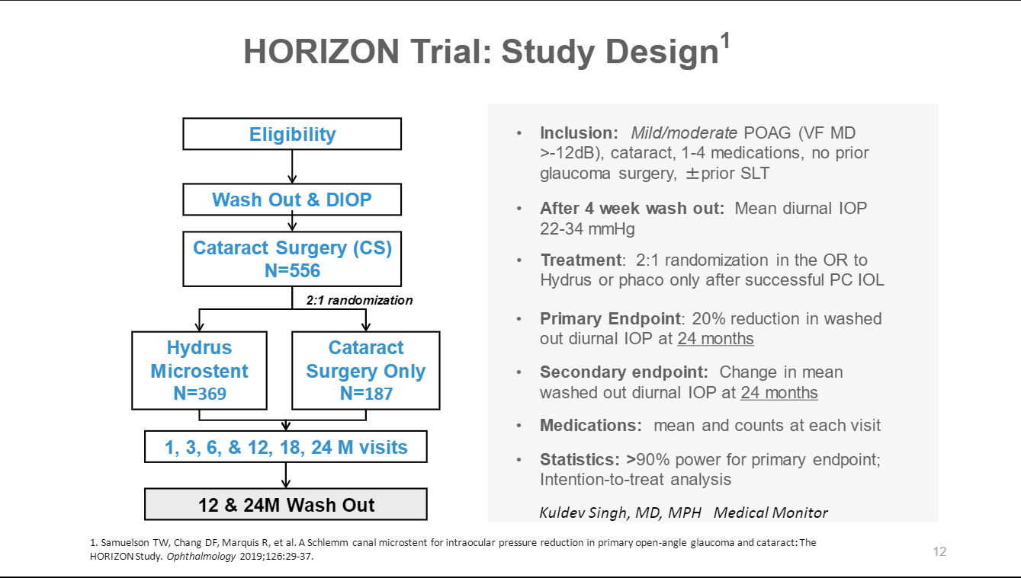

Slide 45
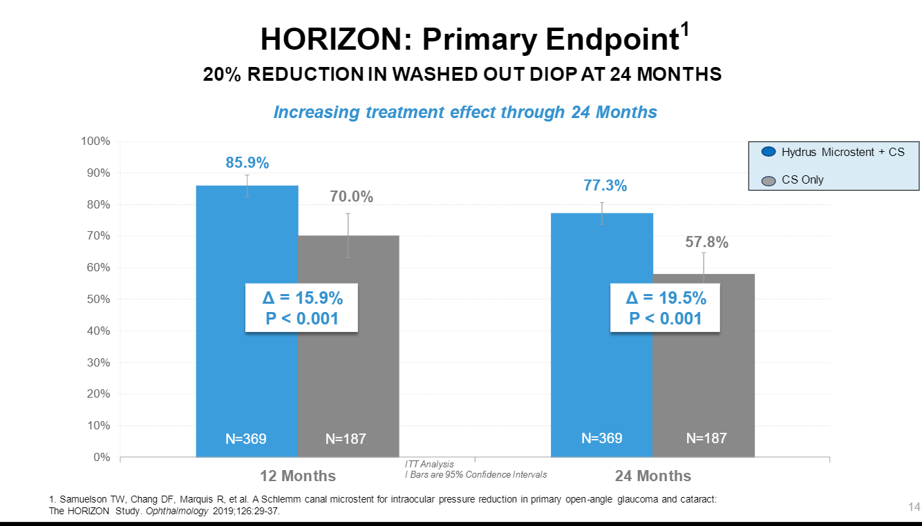

Slide 46
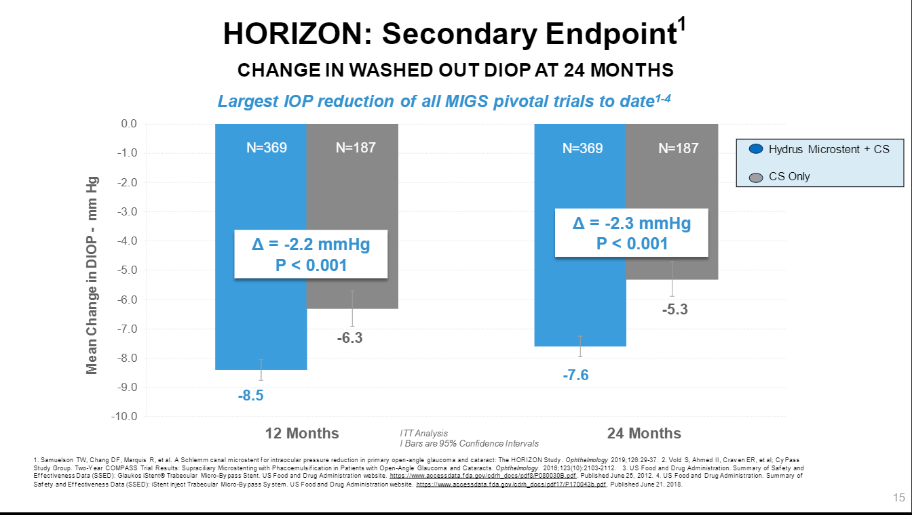

Slide 47
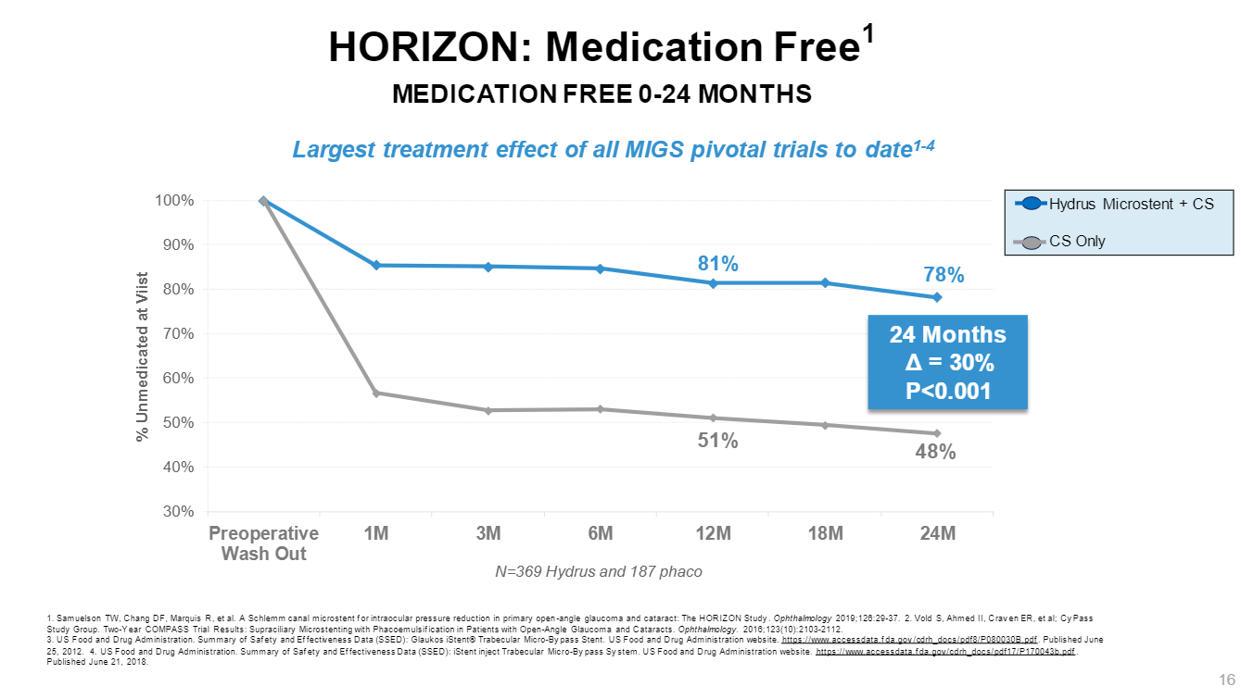

Slide 48
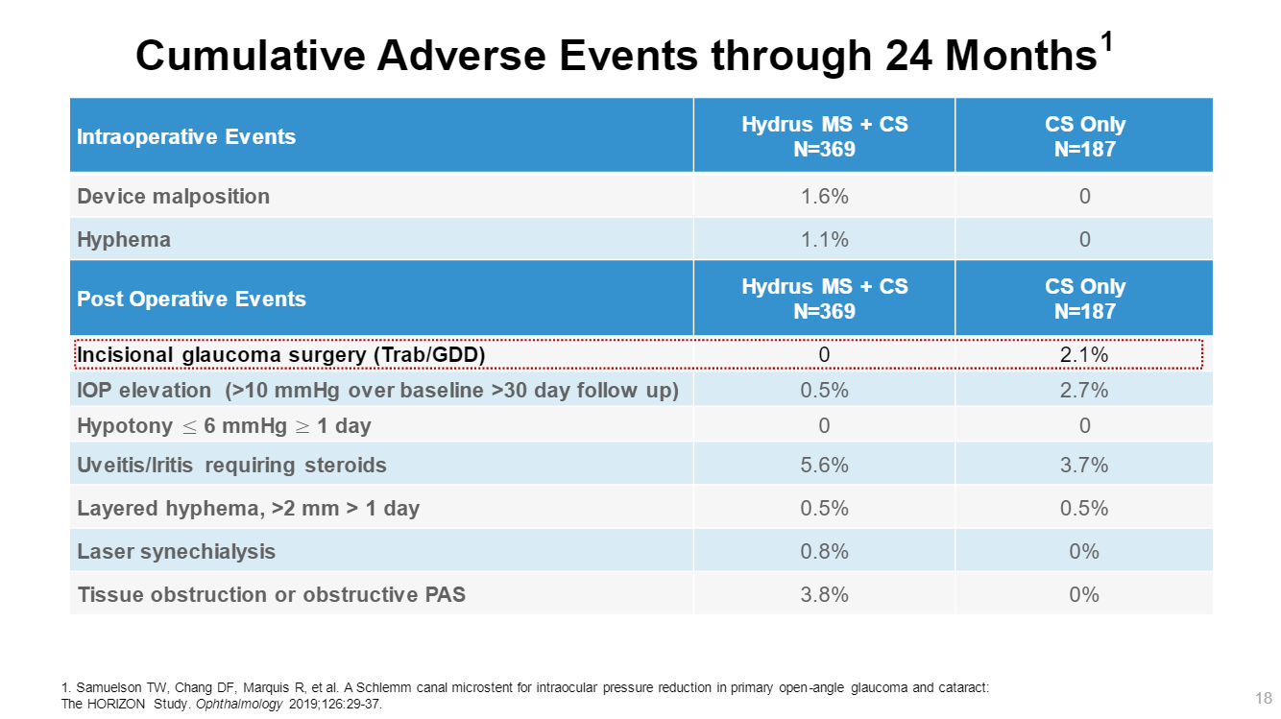

Slide 49
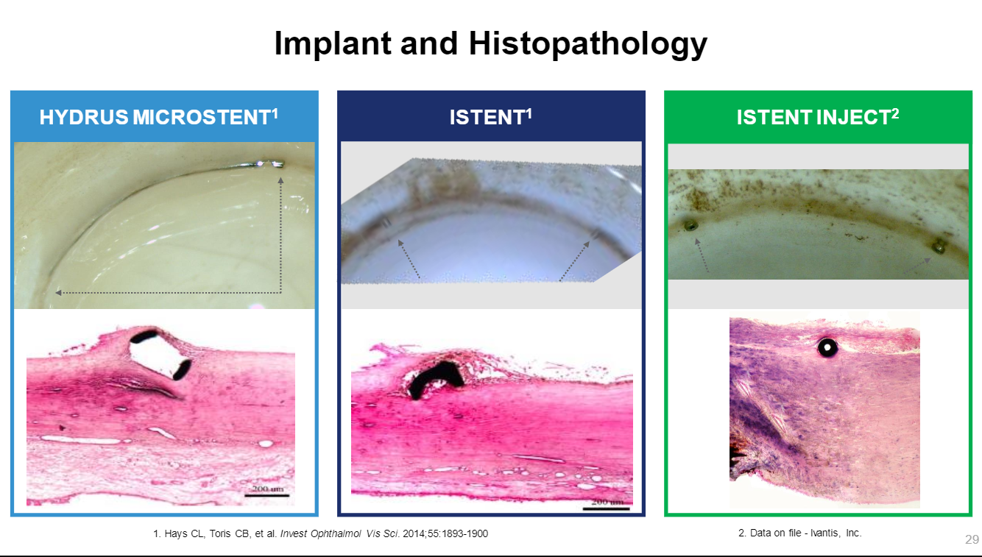
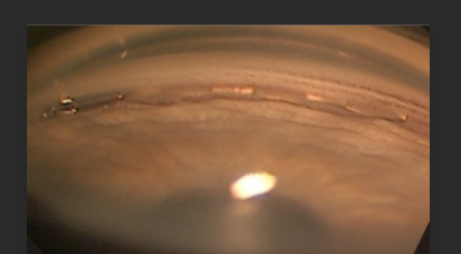

Slide 50
MIGS and iStent Inject overview

Slide 51
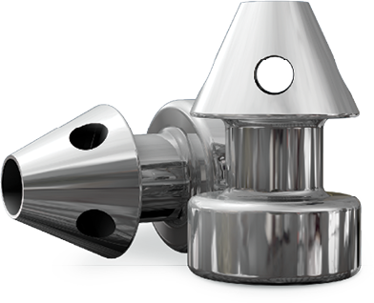
The iStent inject Trabecular Micro-bypass
For patients with cataracts and glaucoma, iStent inject is:
FDA approved therapy for the treatment of elevated IOP in adult patients with mild-to-moderate primary open-angle glaucoma in conjunction with cataract surgery
The first available ab interno, micro-bypass system designed to restore natural physiological outflow through two openings through the trabecular meshwork
Excellent safety profile similar to that of cataract alone

Slide 52
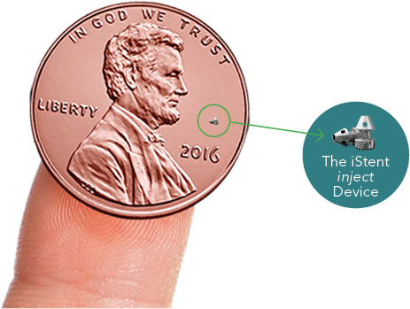
iStent inject Attributes
Creates two patent bypasses through the trabecular meshwork to restore natural outflow
Effectively reduces IOP
Optimizes aqueous outflow through the natural physiologic pathway
Can reduce or eliminate the need for glaucoma medications (at discretion of eye care professional)
Excellent overall safety profile similar to cataract surgery alone

Slide 53
Preoperative Considerations

Slide 54
Who is an iStent inject Candidate?
Patients undergoing cataract surgery with mild-to-moderate primary open-angle glaucoma (what about OHT?)
Cataract surgery patients who could benefit from better control of their IOP, which may allow for their medications to be reduced
Patients wanting to decrease risk of IOP fluctuations associated with medication compliance or who are non-adherent to prescribed regimens
Patients looking to avoid the risks of more invasive procedures
Patients challenged in paying for medications or who cannot tolerate medications or have experienced negative side effects of glaucoma medications

Slide 55
Surgical Procedure
iStent Inject

Slide 56
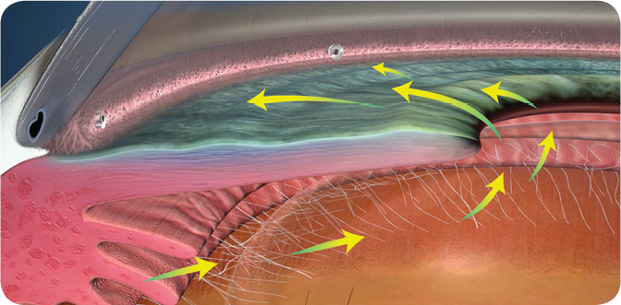
iStent inject Surgical Procedure
Placed in the eye during cataract surgery
The procedure is straightforward, astigmatically-neutral, and minimally traumatic to the eye
iStent inject has an overall safety
profile similar to cataract surgery
Reduces the risk of hypotony by utilizing the natural episcleral venous pressure

Slide 57
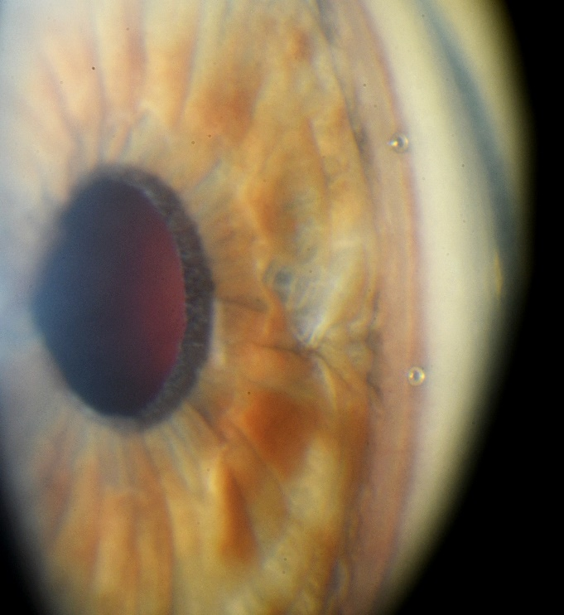
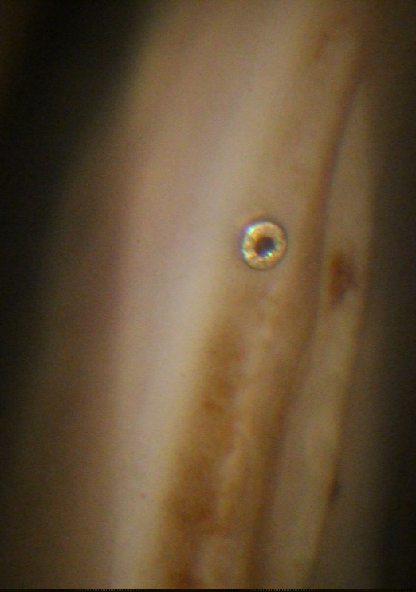
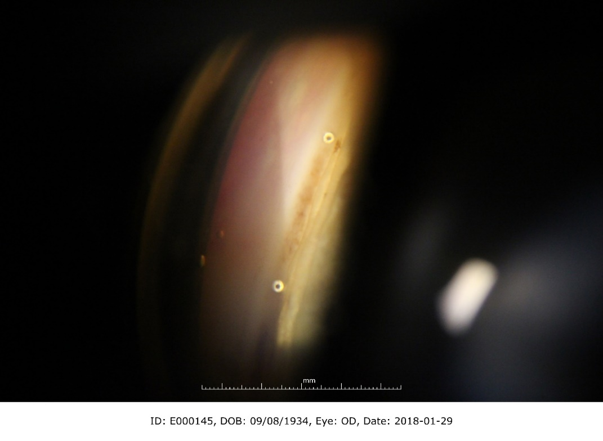
iStent inject Post-Op Images
Courtesy of Dr. Marc Toteberg
2-year post-op
Courtesy of Dr. George Reiss
Notes:
Note to presenter: Option to delete these images and include your own iStent inject videos or images

Slide 58
Clinical Results

Slide 59
iStent inject Pivotal Trial
Study Design
Prospective, multicenter, 3:1 randomized controlled trial
iStent inject + phaco vs. phaco alone
Follow-up through 24 months, with baseline and annual washouts
505 total subjects randomized
Study met all effectiveness endpoints
High safety profile, similar to cataract surgery alone
Efficacy Endpoints
Primary: ≥ 20% reduction in unmedicated DIOP
Secondary: Mean reduction in unmedicated DIOP

Slide 60
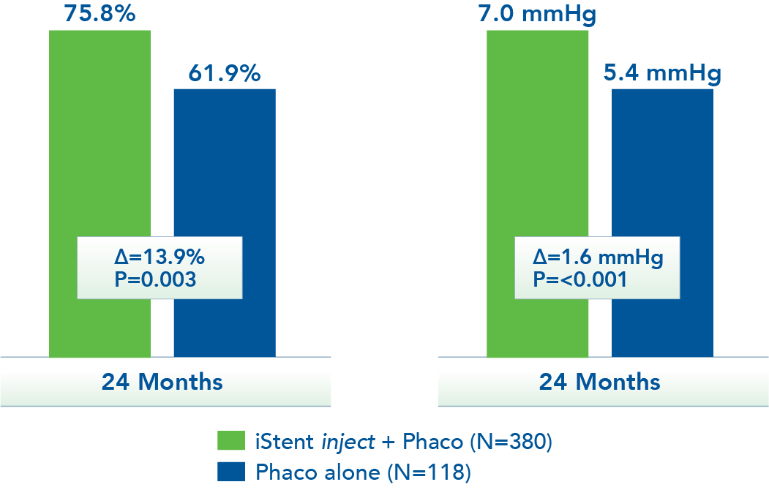
iStent inject PIVOTAL TRIAL
PRIMARY ENDPOINT:
≥ 20% Reduction in Unmedicated DIOP
SECONDARY ENDPOINT:
Mean Unmedicated
DIOP Reduction

Slide 61
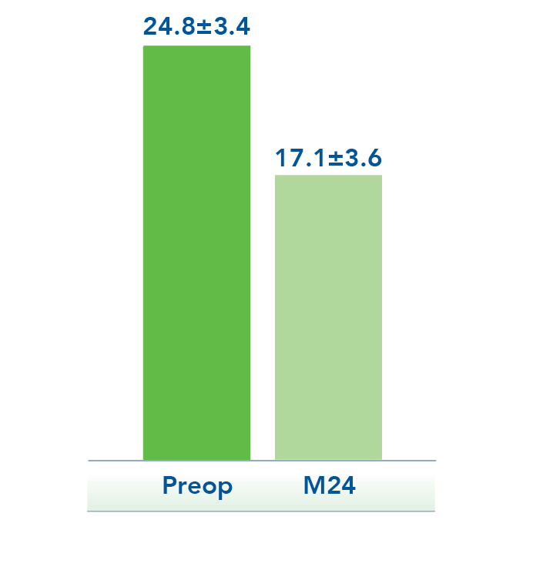
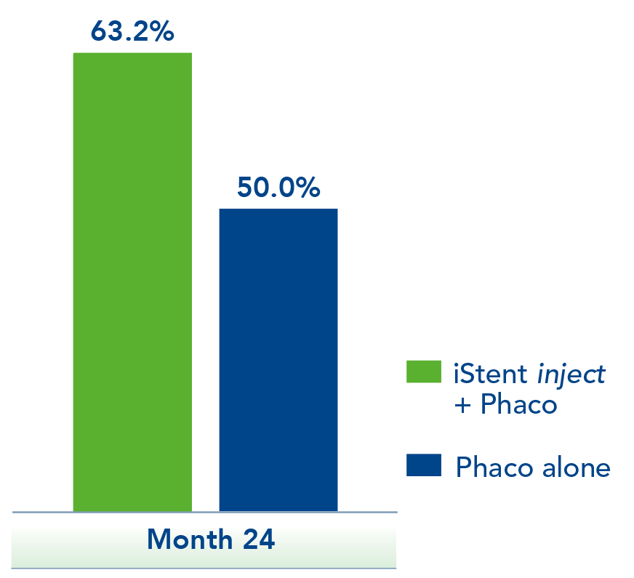


iStent inject PIVOTAL TRIAL
Change in Unmedicated DIOP –
iStent inject + Phaco
Unmedicated DIOP ≤ 18 mmHg
31%
reduction from baseline
84% of iStent inject subjects medication-free at 23 months

Slide 62
iStent inject PIVOTAL TRIAL
Safety Profile
iStent inject demonstrated an overall high safety profile, similar to cataract surgery alone
NO REPORTS OF:
Myopic shift
Flat AC
Choroidal hemorrhage or effusion
Cyclodialysis
Hypotony ≥ 1 month
Hypotony maculopathy
Stent dislocation
Significant hyphema
Corneal decompensation
Post-Op Adverse Events | iStent inject + Phaco N = 386 | Phaco Only N = 119
Stent obstruction | 6.2% | NA
Intraocular inflammation | 5.7% | 4.2%
BSCVA loss ≥ 2 lines at or after 3 months postoperative | 2.6% | 4.2%
IOP increase ≥ 10 mmHg ≥ M1 | 2.1% | 0.8%
Corneal abrasion | 2.1% | 3.4%
Goniosynechiae | 1.8% | 0.0%
IOP increase requiring oral meds or SSI onset ≥ M1 | 0.3% | 2.5%
Secondary glaucoma surgery
SLT | 0.5% | 2.5%
Trabeculectomy/Express shunt | 1.0% | 0.8%

Slide 63
KEY GLOBAL DATA POINTS
Pivotal Trial Data- US
  The study met all effectiveness endpoints
    At 24 months, the mean reduction in unmedicated DIOP was 7.0 mmHg
    At 24 months, 75.8% met the primary endpoint of ≥ 20% reduction of unmedicated DIOP from baseline
    84% of iStent inject subjects that were responders were medication-free at 23 months
  High safety profile, similar to cataract surgery alone
Hengerer 3 yr data- Germany
  At 3 yrs, 100% of patients with IOP ≤ 18 mmHg
  This demonstrates treatment still safe and effective at 3 yrs

Slide 64

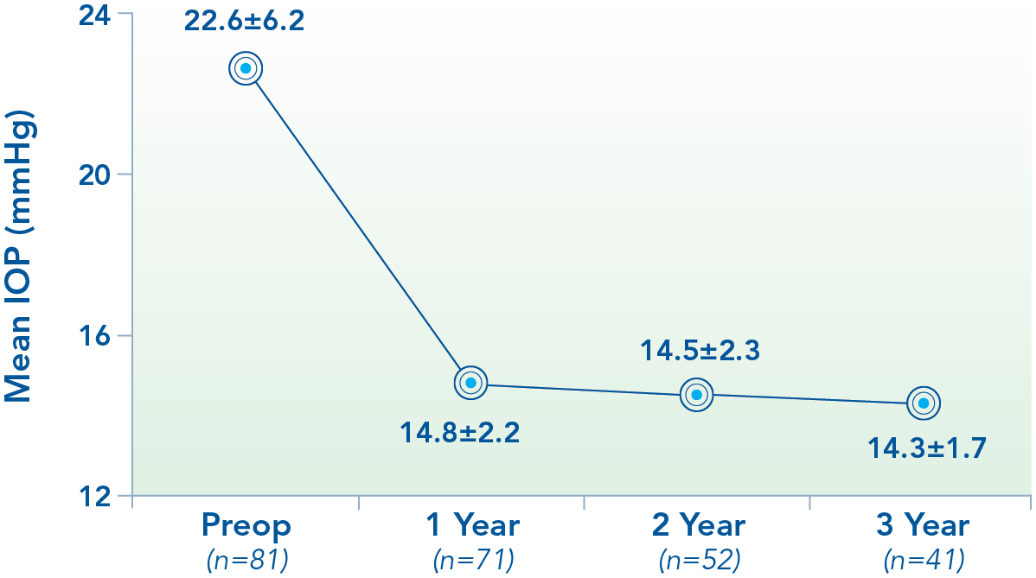
HENGERER (3 YEAR)
Long-term IOP Reduction at 3 Years
Intraocular Pressure Over Time
37%
reduction from preop IOP
37%
100%
of patients with IOP ≤ 18 mmHg

Slide 65

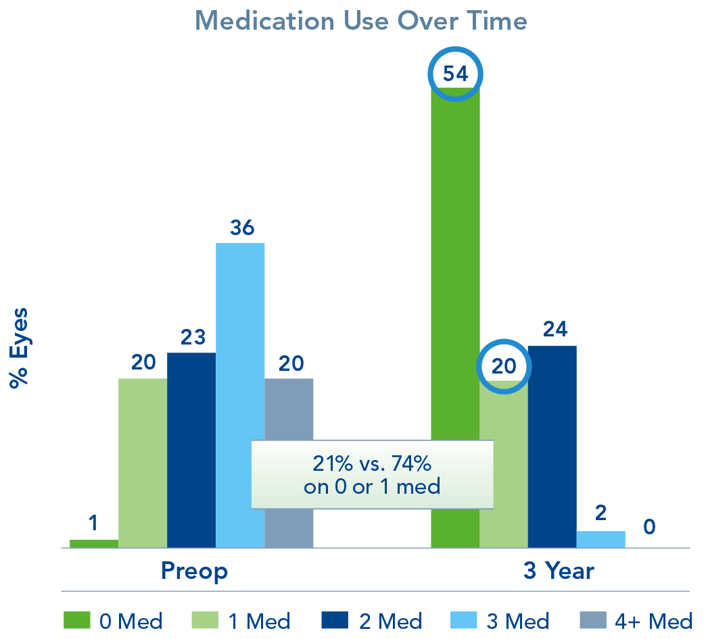
HENGERER (3 YEAR)
Sustained Medication Reduction
Medication Use Over Time
74%
on 0 or 1 medications at 3 years compared to 21% preop
68%
reduction in mean medications
Medication use decreased from 2.5 to 0.8

Slide 66
KEY GLOBAL DATA POINTS
Harasymowycz 1 yr data- Canada
  Medication use decreased from 2.3 to 1.2, with 45% medication-free
  80% of eyes with ≥ 1 med reduction
  43% reduction in mean number of medications
Clement 1 yr data- Australia
  66% are medication free at 1 year
  Medication use decreased from 1.7 to 0.6
  65% reduction in mean number of medications

Slide 67


HARASYMOWYCZ (6 MONTH - 1 YEAR)
LARGE RETROSPECTIVE STUDY – INITIAL RESULTS
Retrospective case review with iStent inject from a single clinic in Montreal
80%
of eyes with ≥ 1 med reduction
  n=179 eyes of 105 patients
  Evaluation of IOP and medication reduction following implantation of iStent inject with concomitant cataract surgery in glaucoma patients
  6 months - 1 year outcomes presented with continued data collection
43%
reduction in mean medications
Medication use decreased from 2.3 to 1.3, with 45% medication-free

Slide 68

1 YEAR DATA (CLEMENT)
Real-World Results with 1 Year Follow Up
Retrospective case study pooling data from four surgeons in Australia
66%
medication-free vs. 18% preop
  n=172 eyes analyzed at 1 year
  Evaluation of iStent inject in combination with cataract surgery
  Continuing follow-up planned on all eyes
  High safety profile observed
65%
reduction in mean number of meds
Medication use decreased from 1.7 to 0.6

Slide 69
May Help Meet the Needs of Your Practice
Prevalent Patient Profile
  Adults with mild-to-moderate POAG
  Undergoing cataract surgery
Complete Procedure
  Two multi-directional stents designed to restore natural outflow
  Address cataract and glaucoma together
  Possible medication reduction could yield OSD symptom improvement
  Easy to integrate into surgical flow for an accomplished surgeon
Patient Retention
  Clinically proven IOP reduction may help prevent glaucoma progression and may decrease the patient’s need for more invasive surgery
Predictable Co-Management
  Fits easily alongside cataract co-management
  iStent inject has an excellent overall safety profile similar to cataract surgery alone

Slide 70
Glaukos OD Portal Video Collection
Introductory and Comprehensive Content
Advanced Content
OD’s Role in Treating Glaucoma
iStent inject Overview
MIGS Algorithm
Referring Best Practices
Long-Term Efficacy, Safety and Ongoing Evaluation
In-Office Gonioscopy
Medication Tapering
Patient Education: Full Practice Support & Resources
iStent and iStent inject Differences
Core Content
The Ideal Patient for iStent inject
Talking to Your Patients about iStent inject
iStent inject Procedure
Data Overview of iStent inject
Safety of iStent inject
Post-op Comanagement Pearls and What to Expect
Adjunctive Content
iStent inject in the Premium Cataract Patient
OSD: iStent inject Considerations
iStent inject Education for OD Students
Notes:
We’ve put together a series of 18 videos that are each about 5-8 minutes in length; all these videos feature ODs speaking to ODs so the content is relevant and relatable to referring physicians and provide content-specific video segments in a format that is quickly digestible and engaging.

Slide 71
Case #1
82 y/o AAM treated since 2009 for POAG and Cataracts
Over the years, 2 medications were needed to lower IOP adequately
Has tried Latanoprost, Travatan, Lumigan. Successful control varied and insurance coverage always played a role
Current regimen is ZIOPTAN QHS OU and TXE QAM OU.
IOP typically ranges from 12-15 depending on visit and time of day
NKDA
Over the years, OAG has been relatively stable but vision deteriorating from cataract growth

Slide 72





Slide 73



Slide 74



Slide 75
By Fall of 2019, vision had dropped enough to warrant referral for surgery
Discussed improving vision but also trying to reduce eyedrop burden
BCVA 20/40 OD, 20/50 OS
IOP was 15/16 on 2 meds at time of referral
EOMS and PUPILS WNL
Glare 20/200 OU
Consented for cataract extraction with iStent Inject OU
Goal: Improve vision and reduce number of eyedrops used

Slide 76
Post-op Protocol:
Prescribe same steroid, NSAID and antibiotic regimen as with cataract surgery alone
  Tapering more quickly may be warranted at times to help reduce IOP if steroid responder
1-Day Post-op visit same as before
Do not stop glaucoma meds at this time, allow eye to heal first and stabilize before reducing OAG meds
Return in 1-2 weeks to perform GONIO to visualize MIGS placement

Slide 77
1-Day Post-op OD reveals UCVA 20/20 and IOP of 14/15
Broken Bag resulted in 3-piece IOL in sulcus but no vitreous prolapse
2 Week Post-Op OD has UCVA 20/20 with IOP of 11/15
1-Day Post-op OS reveals UCVA 20/40 and IOP of 11/13, PC IOL in the bag
2 Week P/O OS has UCVA 20/20 OU with IOP of 09/10
Instructed to D/C Timolol and continue ZIOPTAN QHS OU
3 mos later, VF is stable and IOP is 10/12 on Zioptan QHS OU

Slide 78
Case #2
70 y/o WM has been treated for MILD OAG for the last 15 years
C/D 0.50 OD, 0.55 OS
Baseline IOP was 26 mm Hg OU
Current treatment is LATANOPROST QHS OU and TXE QAM OU
Resulting IOP was 18 mm Hg OU
By late 2018, had developed visually significant cataract (3-4+ NS)

Slide 81
Consented for CATARACT surgery AIM -2.25 with iStent Inject implantation OU
OS done first
1-Day revealed 20/400 UCVA, IOP 15
Instructed to use surgical drops & continue IOP meds
2-week P/O BCVA 20/20, IOP 14, GONIO shows well placed iStent Inject nasally
Continue OAG meds for now, finish surgical drops

Slide 82
OD done with same parameters
1-day UCVA 20/200, IOP 23
Use surgical drops and OAG meds
1-week P/O BCVA 20/20 OU, IOP 14 OU
3-weeks later BCVA 20/20, IOP 16 OU, iStents in good position OU
Instructed to stop TXE OU and return in 8 weeks
At 18 mos, IOP 16 OU on LATANOPROST only

Slide 83
THANK YOU!
Questions:
smolenyak@hotmail.com

