Slide 1
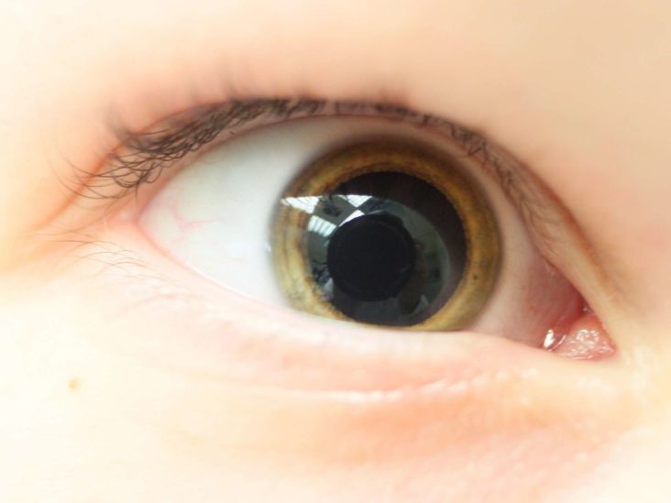
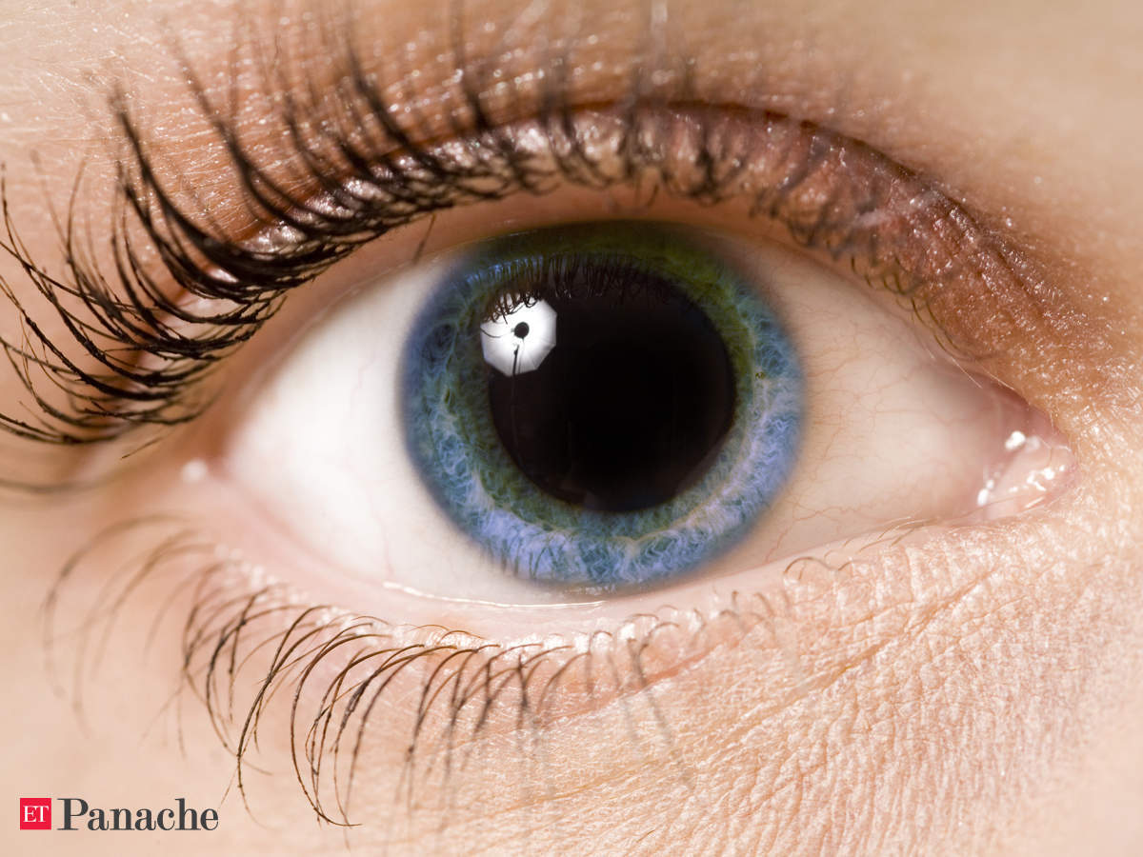
Unilateral Mydriasis
What’s up with the unilateral Mydriasis?
A potentially dangerous, sometimes life-threatening, concern

Slide 2
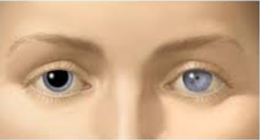
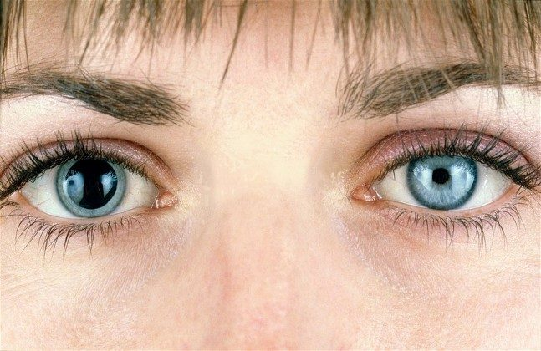
Two patients recently presented with unilateral mydriasis OD.
- This could be caused by an injury (TBI), brain aneurysm, epilepsy, stroke or use of illegal drugs like LSD, amphetamines, cocaine etc.
- Diagnosis might necessitate a CT scan, MRI, drug testing, referral
Fortunately for these patients,…..

Slide 3
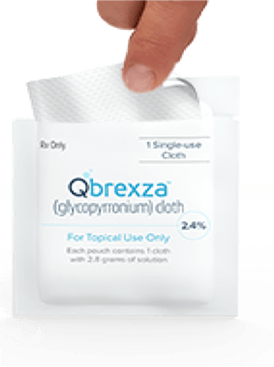
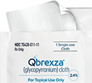
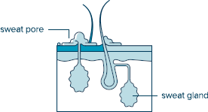
it was Qbrexza…..

Slide 4
Qbrexza
Topical wipe for primary axillary hyperhidrosis (those sweaty underarmies)
Glypyrrconium Tosylate--an anticholinergic
In addition to reducing sweat, it may cause dry mouth, redness, turning/stinging.
It can also cause a dilated pupil, especially
if you touch your eye after using the wipe,
(especially if you don’t wash your hands
prior to inserting your contact lenses!!!)

Slide 5
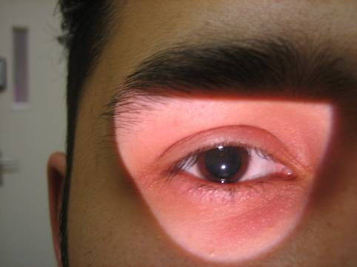
Qbrexza
Additional information/notes
A person does not have to actually touch their eyes in order to have the possibility of an eye dilation.
Mydriasis can take place if a person touches any periorbital tissue.
I am only aware of one case involving contact lenses
Bilateral mydriasis has not been reported, but is certainly a possibility
Mydriasis can happen when patients touch other similar chemicals.
Some patients may experience blurry vision—due to the pharmacologic inability to compensate for astigmatism or hyperopia

Slide 6
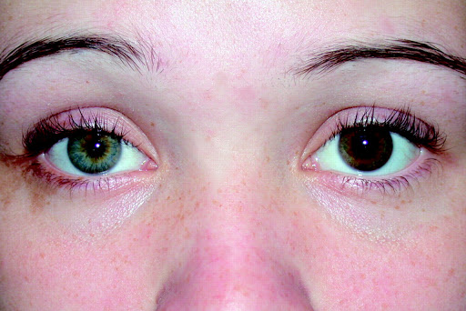
Qbrexza
Treatment
If Qbrexza is implicated as the likely cause of the mydriasis (aka no HA, no neurological or systemic changes):
No other treatment is necessary--Monitor
Reassure the patient
Require the patient to throw away their contact lenses and case
Remind them to wash their hands!
The mydriasis should resolve in in a few days (Most of the literature states 1-2 days, but there have been cases when it has lasted longer.)

Slide 7
Moral of the story…..
PLEASE, PLEASE, PLEASE remind your Qbrexza patients to wash their hands!
They need to wash until the “slimy” feeling is gone.
Share this with your dermatology counterparts.
Questions?

